Slide 1
Aligning Self-Supervised Models with Human Intents
CSCI 601-471/671 (NLP: Self-Supervised Models)
https://self-supervised.cs.jhu.edu/sp2024/

Slide 2
On data: https://huyenchip.com/2023/05/02/rlhf.html
Good content on scaling data.

Slide 3
Things that Generative LMs Can Do
Johns Hopkins University is in _______. [Trivia]
I put _______ fork down on the table. [syntax]
The woman walked across the street, checking for traffic over _______ shoulder. [coreference]
I went to the ocean to see the fish, turtles, seals, and _______. [lexical semantics/topic]
What I got from the two hours watching it was popcorn. The movie was _______. [sentiment]
Thinking about the sequence 1, 1, 2, 3, 5, 8, 13, 21, ___ [basic arithmetic]
[Slide credit: Jesse Mu]

Slide 4
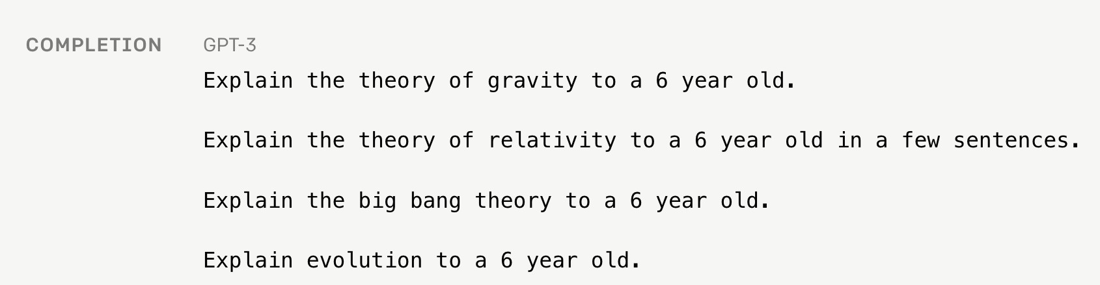
Language Modeling ≠ Following Human Instructions
There is a mismatch between LLM pre-training and user intents.

Slide 5
Language Modeling ≠ Following Human Instructions
Human
A giant rocket ship blasted off from Earth carrying astronauts to the moon. The astronauts landed their spaceship on the moon and walked around exploring the lunar surface. Then they returned safely back to Earth, bringing home moon rocks to show everyone.
There is a mismatch between LLM pre-training and user intents.

Slide 6
Language Modeling ≠ Incorporating Human Values
PROMPT
COMPLETION
It is unethical for hiring decisions to depend on genders. Therefore, if we were to pick a CEO among Amy and Adam, our pick will be _______
GPT-3
Adam
There is a mismatch between pre-training and human values.

Slide 7
Language Modeling ≠ Incorporating Human Values
PROMPT
COMPLETION
It is unethical for hiring decisions to depend on genders. Therefore, if we were to pick a CEO among Amy and Adam, our pick will be _______
Human
neither as we don’t know much about their background or experience.
There is a mismatch between pre-training and human values.

Slide 8
Alignment
There is clearly a mismatch between what pre-trained models can do and what we want.
Addressing this gap is the focus of “alignment” research.
Let’s take a deeper look into what “alignment” is about.

Slide 9
Aligning Language Models: Chapter Plan
On alignment: defining it
Alignment via instruction-tuning
Alignment via reinforcement learning
Alignment: failures, challenges and open questions
Chapter goal: TODO

Slide 10
What is Alignment and Why is it necessary?

Slide 11
“Alignment” with Human Intents
Askell et al. 2020’s definition of “alignment”:
Note, the definition is not specific to tied to language — applicable to other modalities or forms of communication.
AI as “aligned” if it is, helpful, honest, and harmless
[A General Language Assistant as a Laboratory for Alignment, 2021]

Slide 12
TODO: I think there is more here that we can discuss about … alignment:
Sturat Russel’s book
The Alignment Problem book
Nail clipper problem
Some discussion on philosophy of morality/justice might also be appropriate.
I can also discuss “alignment” as a concept between humans or organizations.

Slide 13
Why Computational Frameworks to Alignment?
How do you create / code a loss function for:
What is funny?
What is ethical?
What is safe?
Don’t encode it, model it!
[Slide credit: Nate Lambert]

Slide 14
Slides from Jilian Hadfield should be useful
Asimov principles for robots

Slide 15
Aligning Language Models:
Instruction-tuning

Slide 16
Instruction-tuning (aka supervised learning or behavior cloning)

Slide 17
Aligning Language Models
to human preferences

Slide 18
Instruction-tuning
Finetuning language models on a collection of datasets that involve mapping language instructions to their corresponding desirable generations.

Slide 19
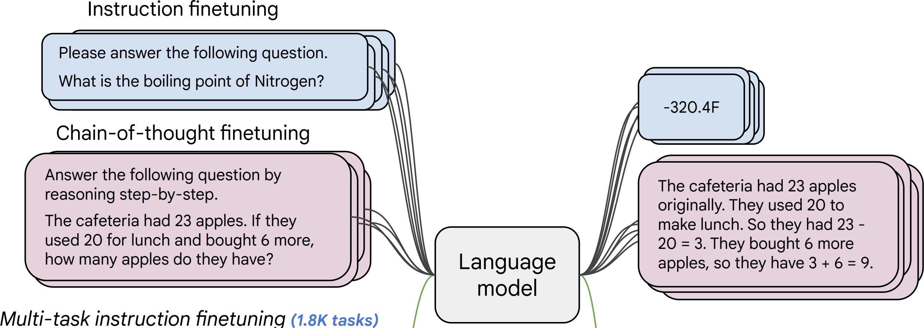
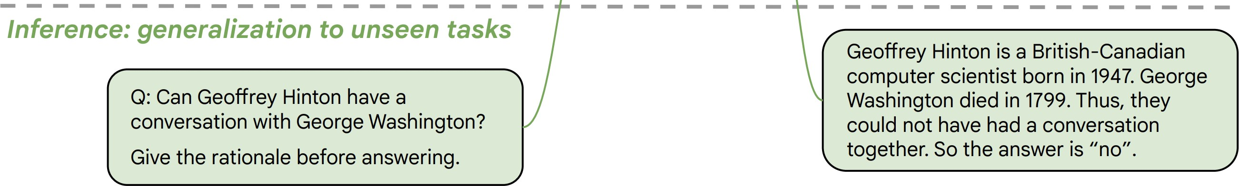
Instruction-tuning
[Weller et al. 2020. Mishra et al. 2021; Wang et al. 2022,
Sanh et al. 2022; Wei et al., 2022, Chung et al. 2022, many others ]
Collect examples of (instruction, output) pairs across many tasks and finetune an LM
Evaluate on unseen tasks

Slide 20
Instruction-tuning: Data
Labeled data is the key here.
Good data must represent a variety of “tasks”.
In traditional NLP, “tasks” were defined as subproblem frequently used in products:
Sentiment classification
Text summarization
Question answering
Textual entailment
Machine translation
…

Slide 21
Instruction-tuning: Data
Labeled data is the key here.
Good data must represent a variety of “tasks”. But what is a “task”?
In traditional NLP, “tasks” were defined as subproblem frequently used in products:
Sentiment classification
Text summarization
Question answering
Machine translation
Textual entailment
What humans need:
“Is this review positive or negative?”
“What are the weaknesses in my argument?”
“Revise this email so that it’s more polite.”
“Expand this this sentence.”
“Eli5 the Laplace transform.”
…
Narrow definitions of tasks.
Not quite what humans want, nevertheless, it might be a good enough proxy.
Plus, we have lots of data for them.
Quite diverse and fluid. Hard to fully define/characterize.
We don’t fully know them since they just happen in some random contexts.

Slide 22
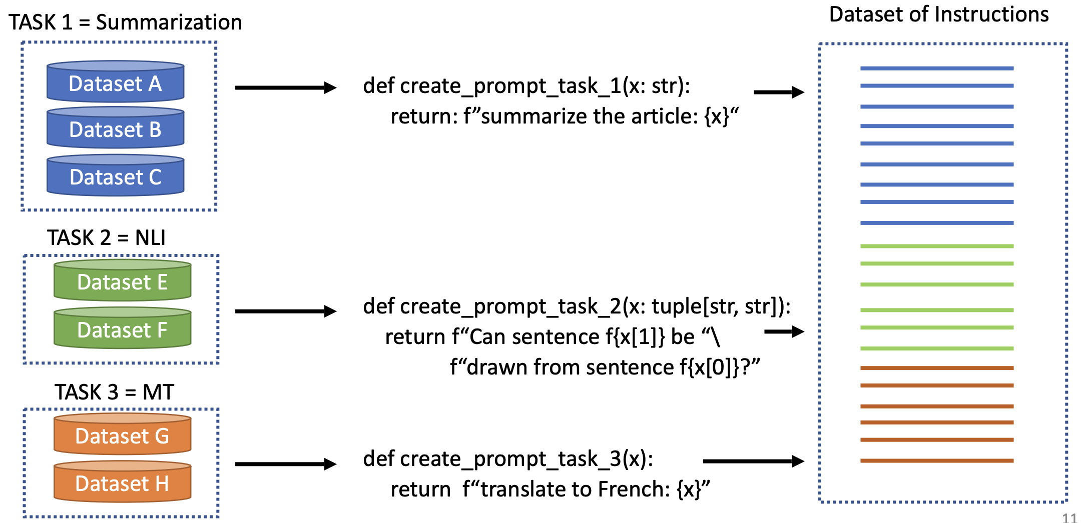
NLP Datasets as Instruction-tuning Data
[Slide credit: Arman Cohan]

Slide 23
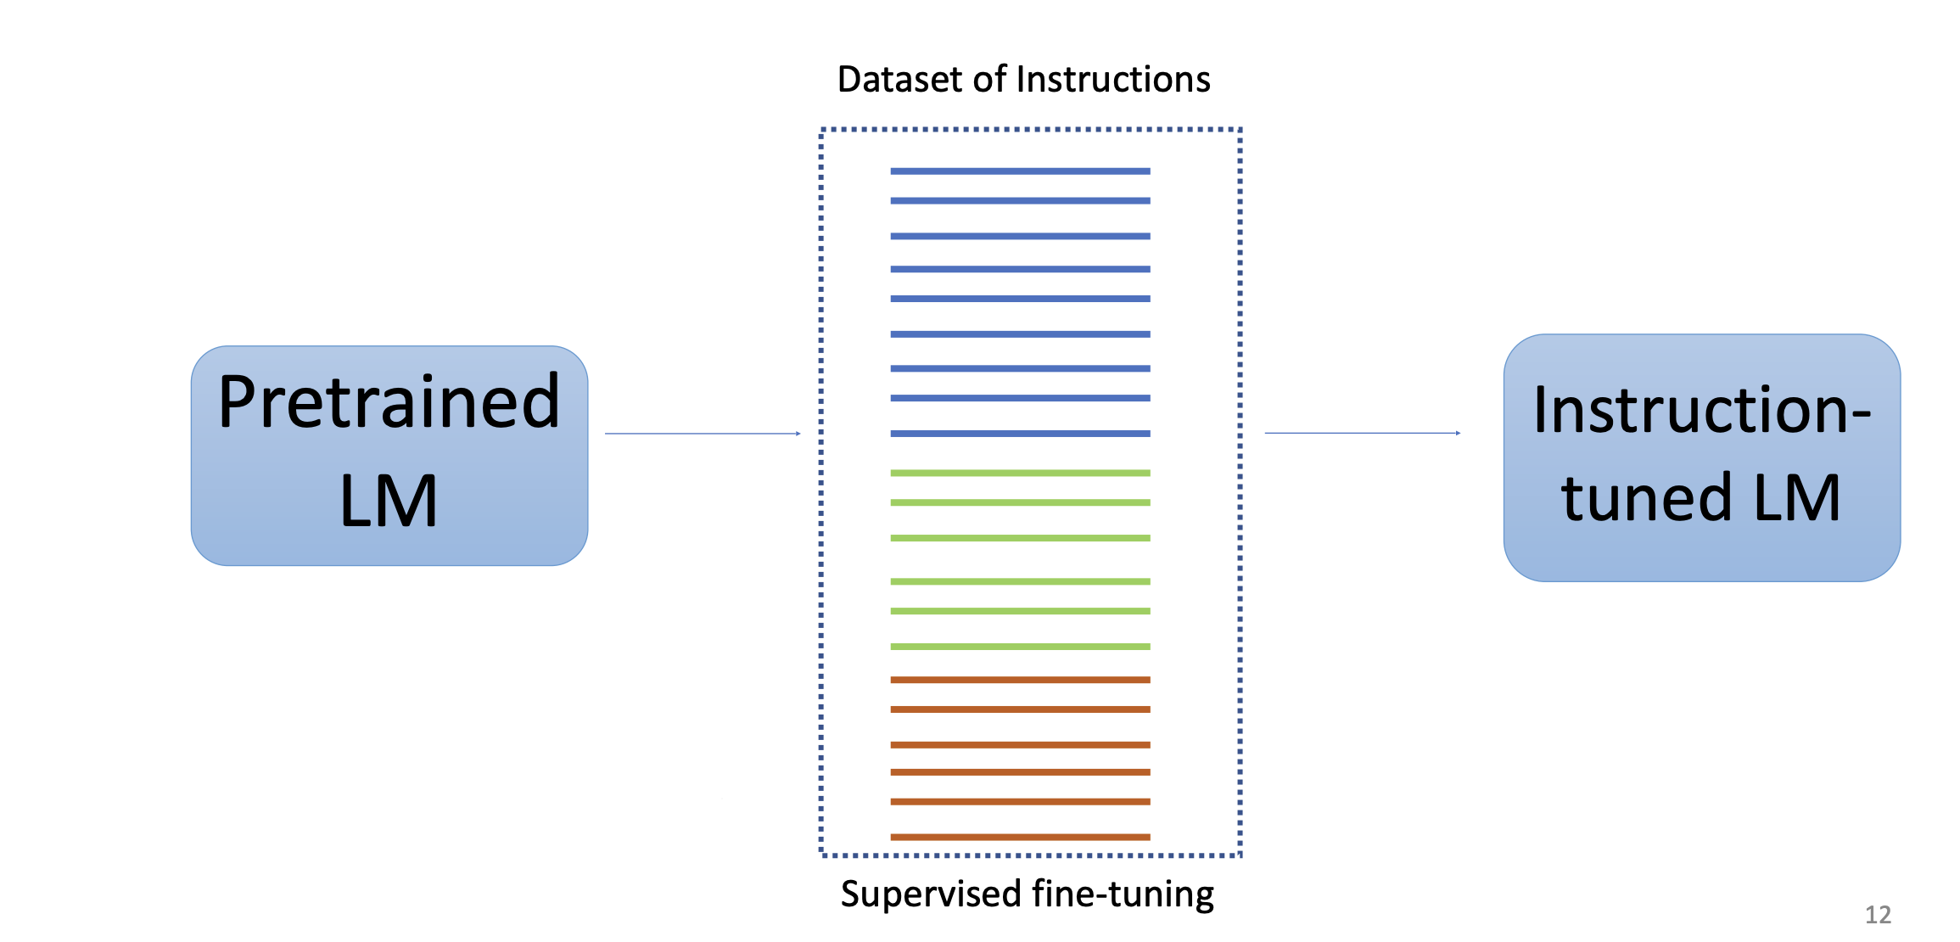
NLP Datasets as Instruction-tuning Data
[Slide credit: Arman Cohan]

Slide 24
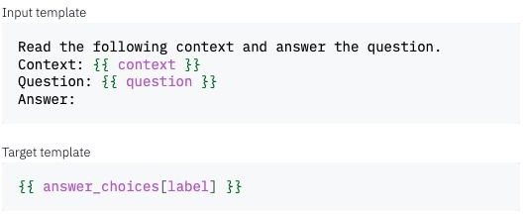
Example
P3: Public Pool of Prompts, now 2085 prompts on 183 datasets
https://github.com/bigscience-workshop/promptsource
https://huggingface.co/datasets/bigscience/P3

Slide 25
Instruction-tuning: Adding Diversity
There is a gap between NLP tasks and use needs.
How do we add more diversity to our data?
In traditional NLP, “tasks” were defined as subproblem frequently used in products:
Sentiment classification
Text summarization
Question answering
Machine translation
Textual entailment
What humans need:
“Is this review positive or negative?”
“What are the weaknesses in my argument?”
“Revise this email so that it’s more polite.”
“Expand this this sentence.”
“Eli5 the Laplace transform.”
…
Narrow definitions of tasks.
Not quite what humans want, nevertheless, it might be a good enough proxy.
Plus, we have lots of data for them.
Quite diverse and fluid. Hard to fully define/characterize.
We don’t fully know them since they just happen in some random contexts.

Slide 26
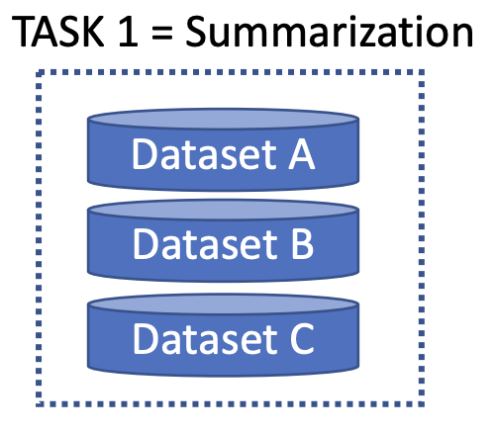
Diversity-inducing via Task Prompts
"Write highlights for this article:\n\n{text}\n\nHighlights: {highlights}"
"Write a summary for the following article:\n\n{text}\n\nSummary: {highlights}"
"{text}\n\nWrite highlights for this article. {highlights}"
"{text}\n\nWhat are highlight points for this article? {highlights}"
"{text}\nSummarize the highlights of this article. {highlights}"
"{text}\nWhat are the important parts of this article? {highlights}"
"{text}\nHere is a summary of the highlights for this article: {highlights}"
"Write an article using the following points:\n\n{highlights}\n\nArticle: {text}"
"Use the following highlights to write an article:\n\n{highlights}\n\nArticle:{text}"
"{highlights}\n\nWrite an article based on these highlights. {text}"

Slide 27
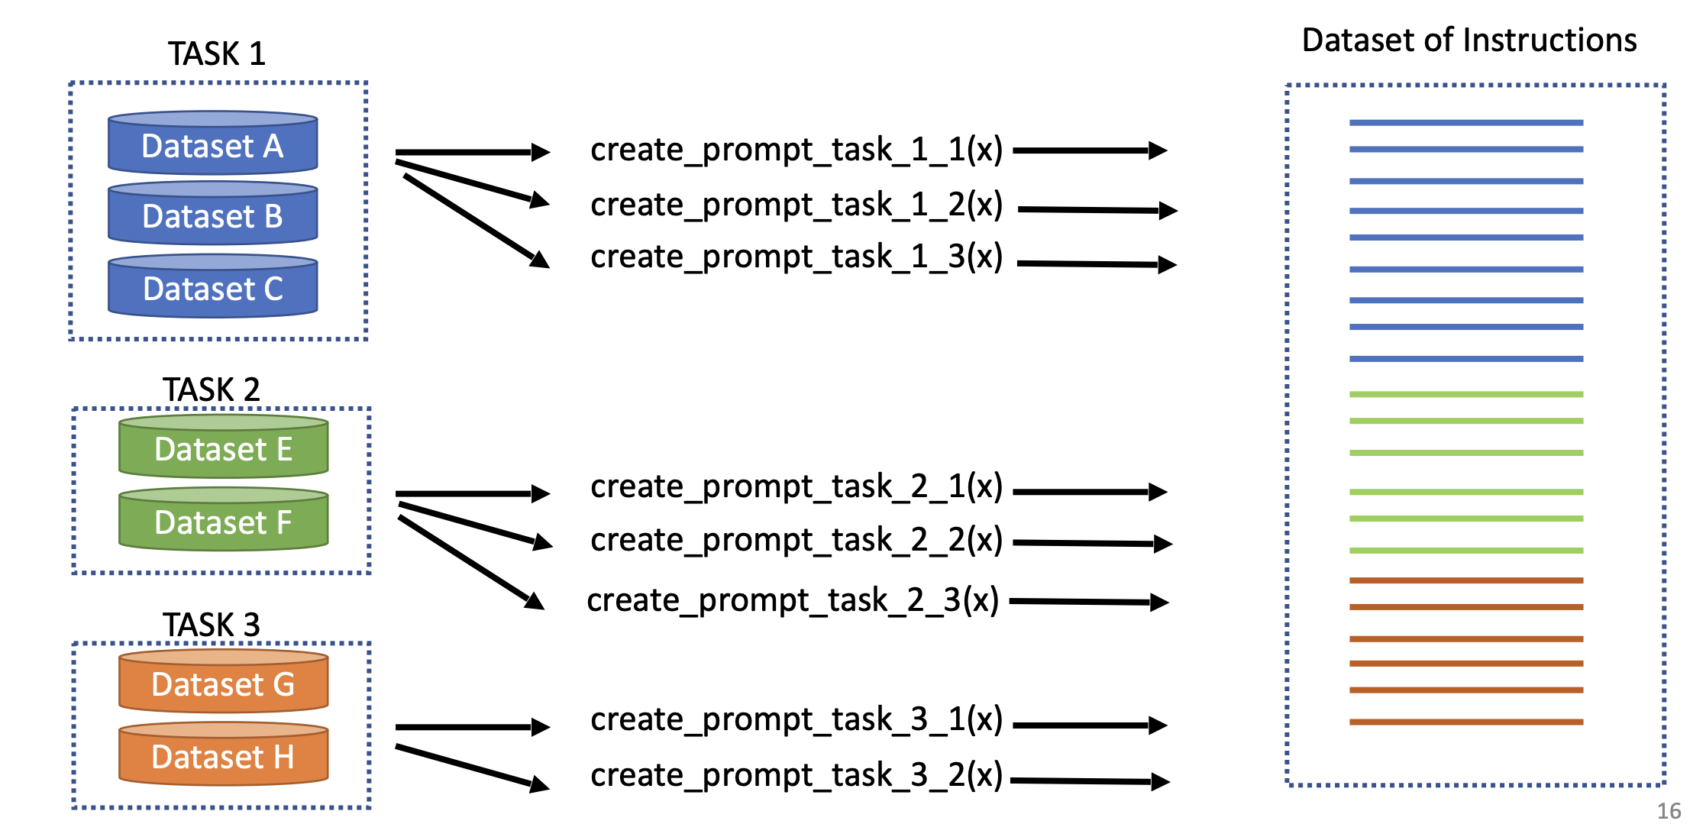
Diversity-inducing via Task Prompts
[Slide credit: Arman Cohan]

Slide 28
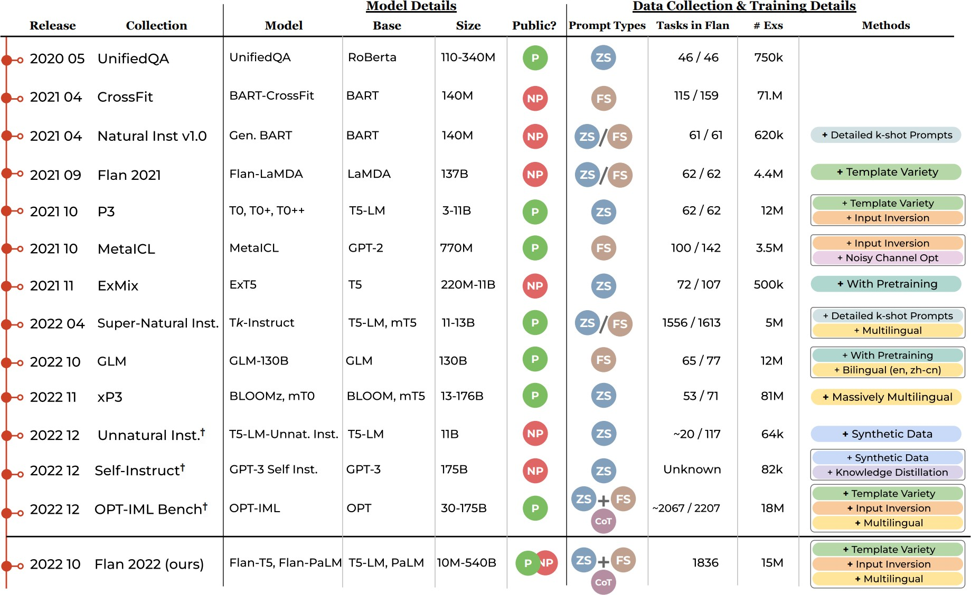
The Flan Collection: Designing Data and Methods for Effective Instruction Tuning (Longpre et al., 2023)

Slide 29
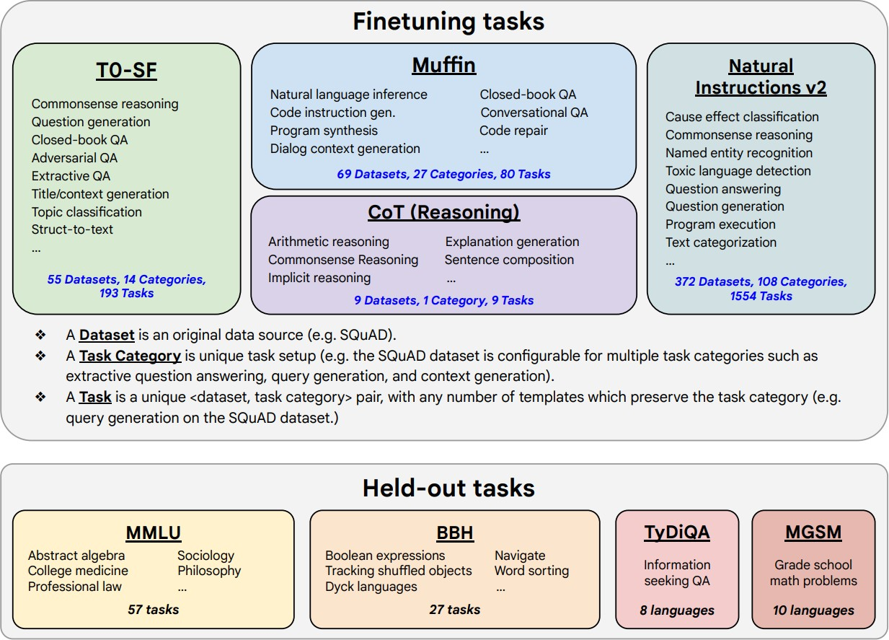
Example Dataset: FLAN Collection
FLAN Collection
Scaling Instruction-Finetuned Language Models (2022)
The Flan Collection: Designing Data and Methods for Effective Instruction Tuning (2023)

Slide 30
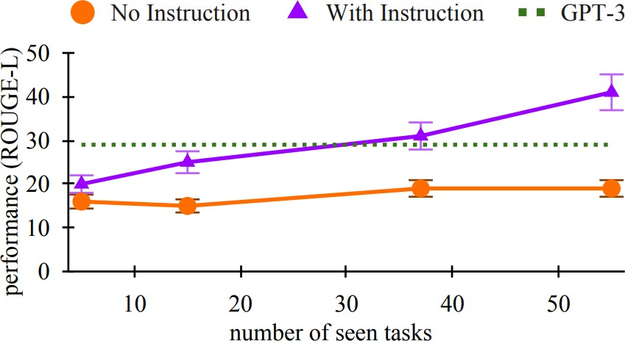
Scaling Instruction-Tuning
Linear growth of model performance with exponential increase in observed tasks.
Cross-Task Generalization via Natural Language Crowdsourcing Instructions (Mishra et al., 2022)

Slide 31
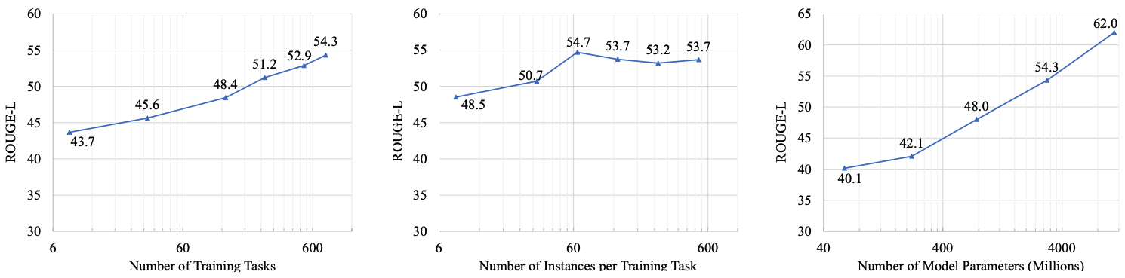
Scaling Instruction-Tuning
Linear growth of model performance with exponential increase in observed tasks and model size.
Number of examples has little effect.
[Super-NaturalInstructions: Generalization via Declarative Instructions on 1600+ NLP Tasks, Wang et al. 2022]

Slide 32
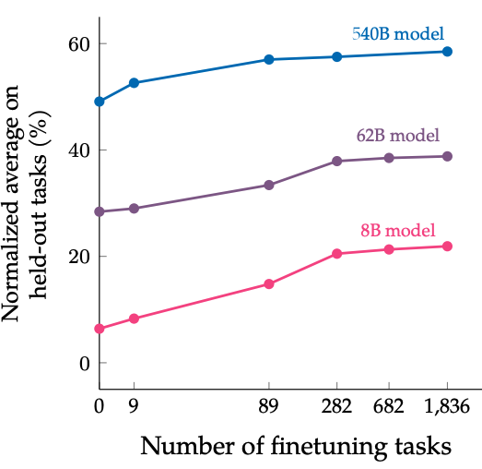
Scaling Instruction-Tuning
Instruction finetuning improves performance by a large margin compared to no finetuning
Increasing the number of finetuning tasks improves performance
Increasing model scale by an order of magnitude (i.e., 8B → 62B or 62B → 540B) improves performance substantially for both finetuned and non-finetuned models
[Scaling Instruction-Finetuned Language Models, Chung et al. 2022]

Slide 33
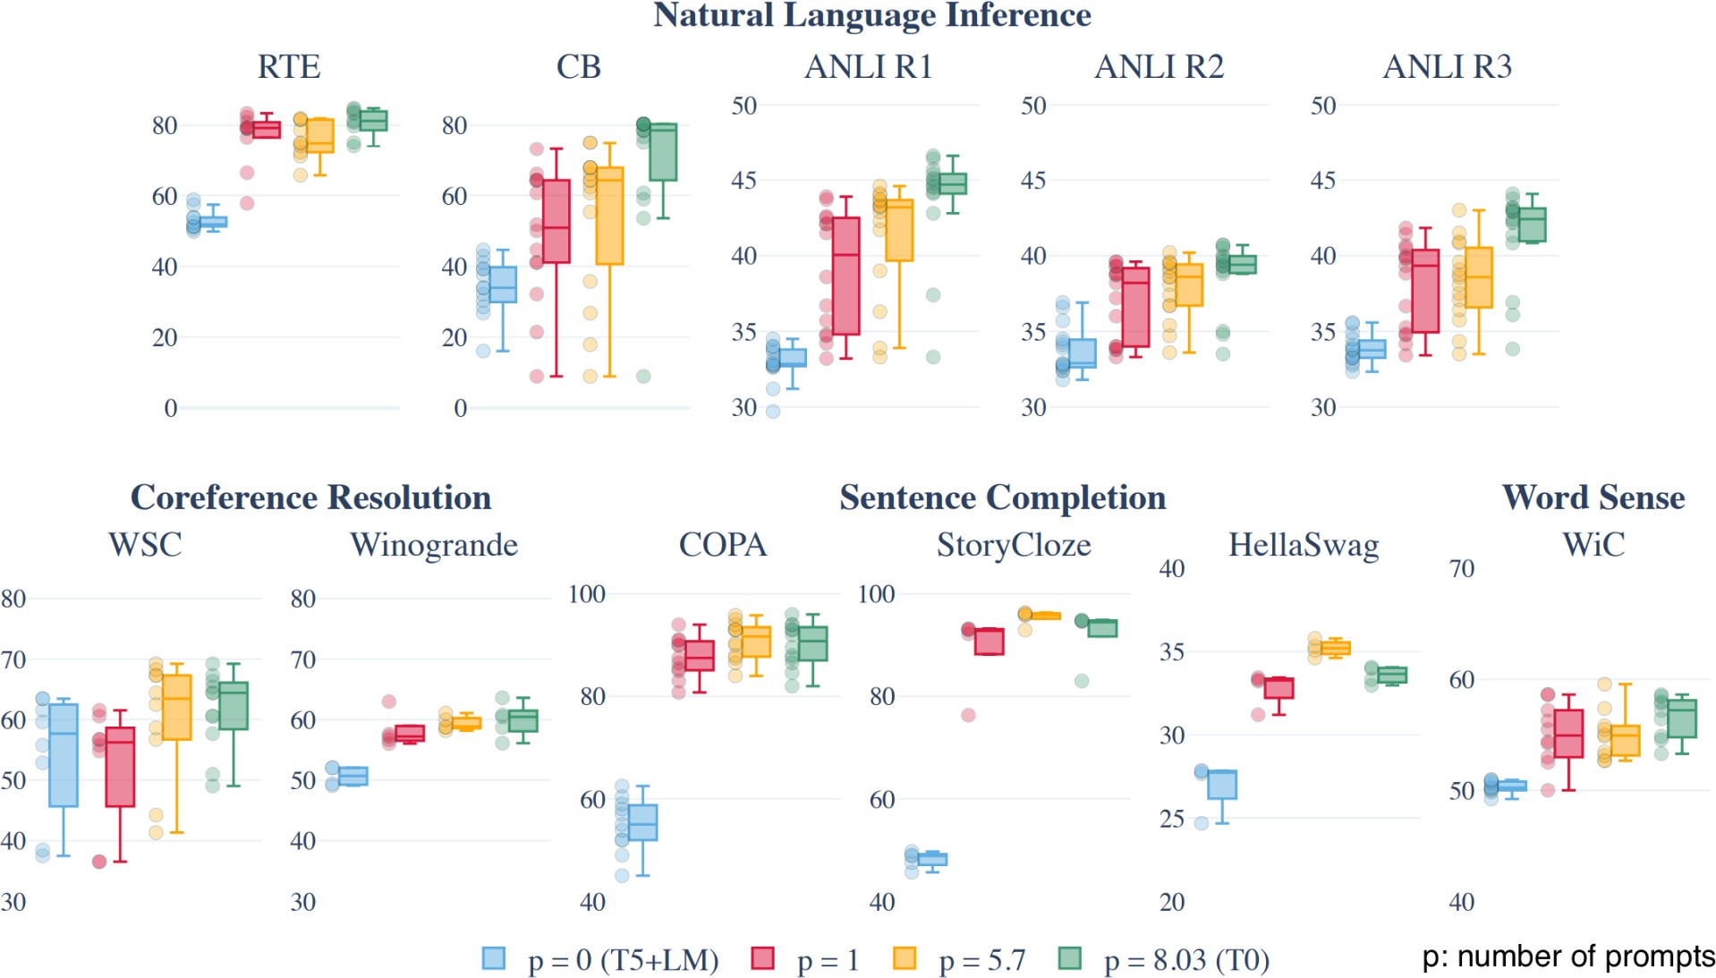
Increasing the number of prompts improves performance and robustness
Multitask Prompted Training Enables Zero-Shot Task Generalization, Sanh et al., (2022)

Slide 34
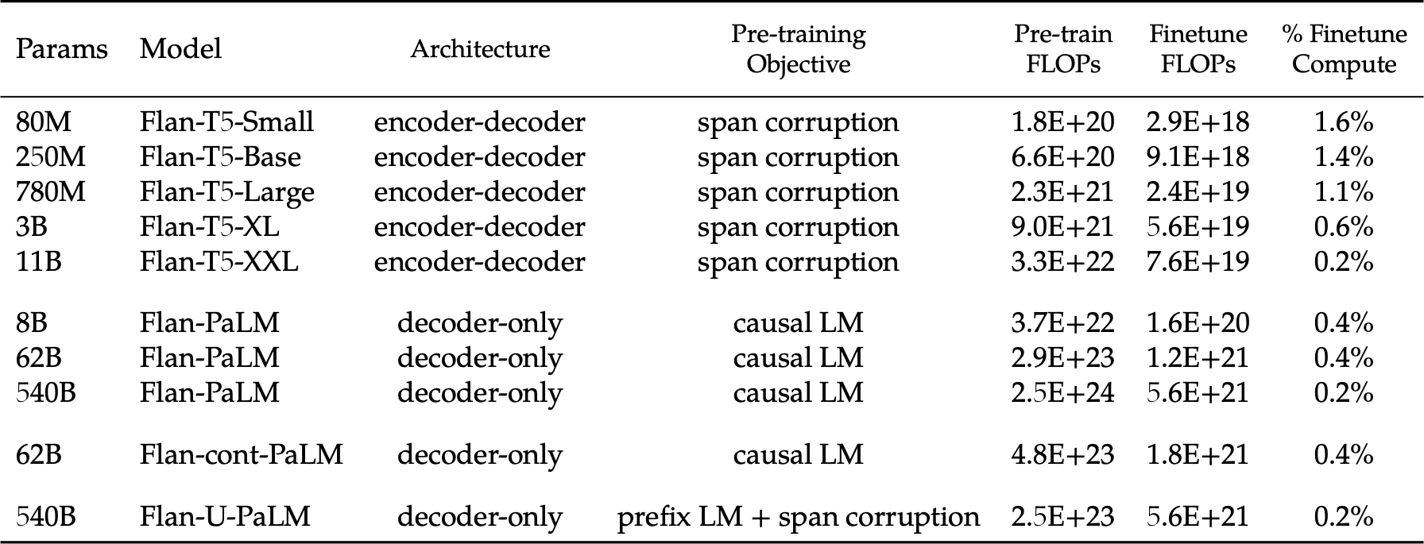
Instruction tuning doesn’t have significant cost compared with pretraining
Scaling Instruction-Finetuned Language Models (2022)

Slide 35
Limits of Instruction-Tuning
Difficult to collect diverse data.
Resulting models may not be good at open-ended generation tasks.
Incentivizes word-by-word rote learning => The resulting LM’s generality/creativity is bounded by that of their supervision data.
LM
Notes:
While ”behavior cloning” is a great starting point for enable models to follow human instructions, ....

Slide 36
Limits of Instruction-Tuning
Difficult to collect diverse data.
Resulting models may not be good at open-ended generation tasks.
Incentivizes word-by-word rote learning => The resulting LM’s generality/creativity is bounded by that of their supervision data.
Resulting models may hallucinate more regularly.
Labeled data is collected agnostic to the LM’s knowledge => there might be a mismatch between labeled data and LM knowledge.
Hence, we may be encouraging “hypocritic” behavior => further hallucinations
Notes:
While ”behavior cloning” is a great starting point for enable models to follow human instructions, ....

Slide 37
Summary Thus Far
Instruction-tuning: Training LMs with annotated input instructions and their output.
Improves performance of LM’s zero-shot ability in following instructions.
Scaling the instruction tuning data size improves performance
Diversity of prompts is crucial
Compared with pretraining, instruction tuning has a minor cost (Typically consumes <1% of the total training budget)
Cons:
It’s expensive to collect ground- truth data for tasks.
This is particularly difficult for open-ended creative generation have no right answer.
Prone to hallucinations.
[Weller et al. 2020. Mishra et al. 2021; Wang et al. 2022, Sanh et al. 2022; Wei et al., 2022, Chung et al. 2022, many others ]

Slide 38
Aligning Language Models:
Reinforcement Learning w/ Feedback

Slide 39
Reinforcement Learning
w/ Human Feedback

Slide 40
Why Reinforcement Learning?
Remember the limits of Instruction-tuning?
Difficult to collect diverse labeled data
Rote learning (token by token) —
limited creativity
Agnostic to model’s knowledge —
may encourage hallucinations
Limited/sparse feedback—usually considered a curse, but now a blessing. “don't give a man fish rather teach him how to fish by himself”
The model itself should be involved in the alignment loop.

Slide 41

Reinforcement Learning: Intuition
Action here: generating responses/token
Reward here: whether humans liked the generation (sequence of actions=tokens)
[figure credit]

Slide 42
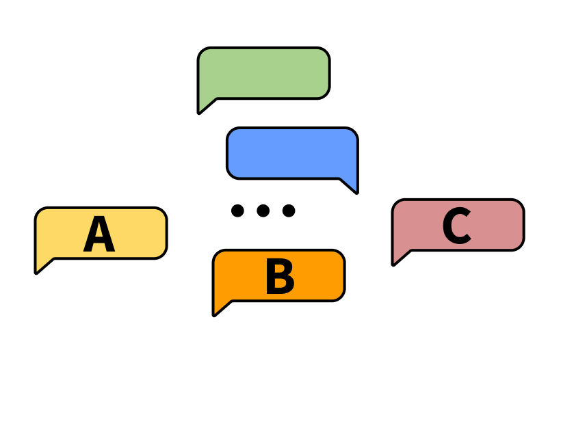
Intuition
Task: choose the better next message in a conversation
Notes:
Forward pointer for who annotates and what the conditions of that are

Slide 43
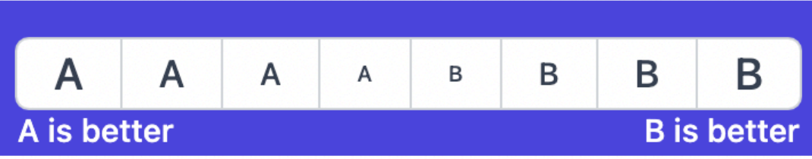
Intuition
Scoring interface: Likert scale or rankings
Notes:
Forward pointer for who annotates and what the conditions of that are

Slide 44
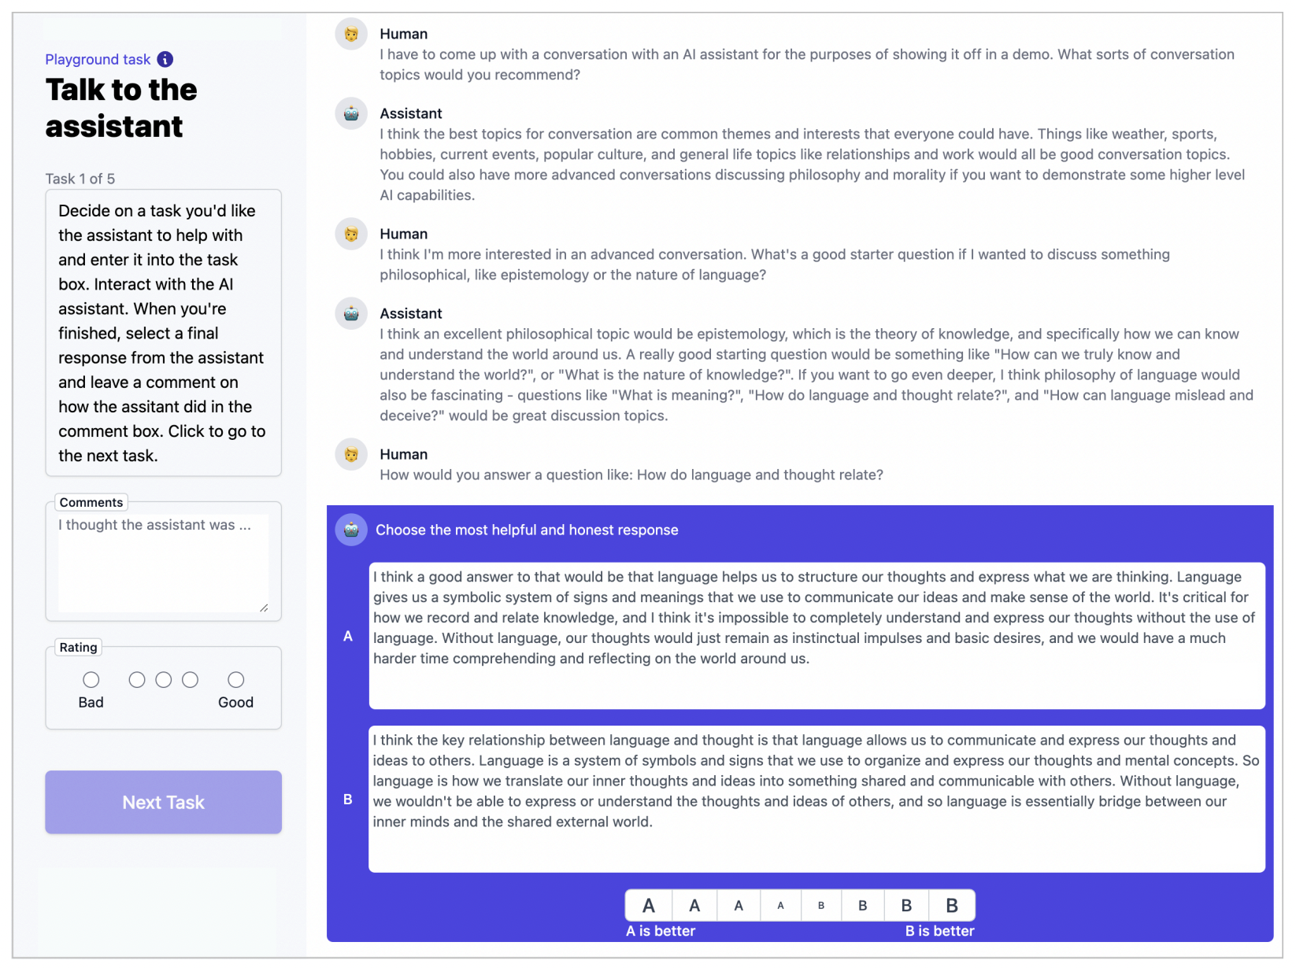
Intuition
human has conversation with the LLM
Notes:
Forward pointer for who annotates and what the conditions of that are

Slide 45
Intuition
LLM provides two options for next responses
Notes:
Forward pointer for who annotates and what the conditions of that are

Slide 46
Intuition
human rates better response
Notes:
Forward pointer for who annotates and what the conditions of that are

Slide 47
Intuition
option to add additional metadata
Notes:
Forward pointer for who annotates and what the conditions of that are

Slide 48

Reinforcement Learning: Abridged History
The field of reinforcement learning (RL) has studied these (and related) problems for many years now [Williams, 1992; Sutton and Barto, 1998]
Circa 2013: resurgence of interest in RL applied to deep learning, game-playing [Mnih et al., 2013]
But there is a renewed interest in applying RL [Ziegler et al., 2019; Stiennon et al., 2020]. Why?
RL w/ LMs has commonly been viewed as very hard to get right (still is!)
RL algorithms that work for large neural models, including language models (e.g. PPO; [Schulman et al., 2017])
[Slide credit: Jesse Mu]

Slide 49
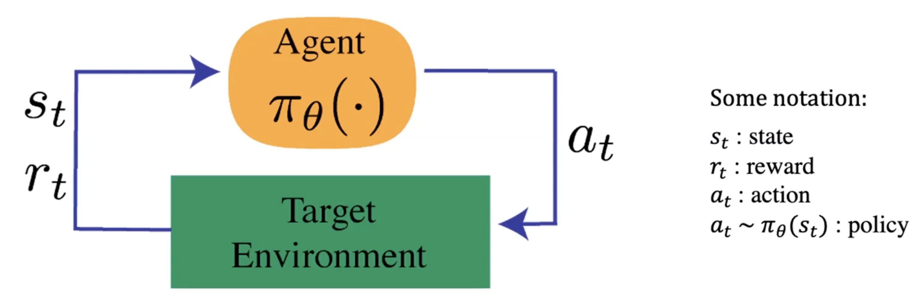
Reinforcement Learning: Formalism
An agent interacts with an environment by taking actions
The environment returns a reward for the action and a new state (representation of the world at that moment).
Agent uses a policy function to choose an action at a given state.
We need to figure out: (1) reward function and (2) the policy function
[Fig credit: Nate Lambert]

Slide 50
Reinforcement Learning: Families
There are a variety of RL algorithms (out of scope for us). Broadly,
Policy-Based Methods, learn a policy function directly.
Takes a state as input and outputs an action (or a distribution over
actions) to take.
We're not too concerned with determining the value or "goodness" of each state-action pair
We just want to know what to do in each state to perform well.
Value-based methods:
the idea is to find the value of each state or state-action pair, and then act in a way that maximizes these values.
PPO

Slide 51

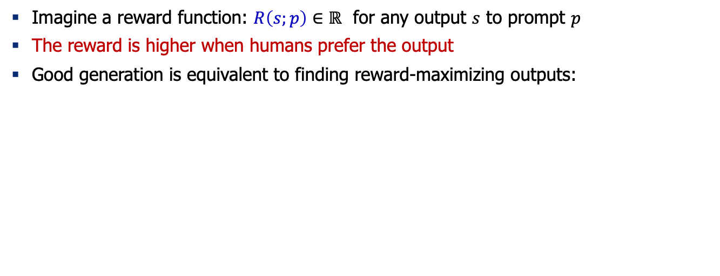
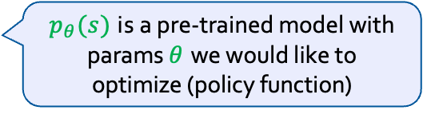
Reinforcement Learning from Human Feedback
Imagine a reward function: $R\left(s;p\right)∈ℝ$ for any output $s$ to prompt $p$
The reward is higher when humans prefer the output
Good generation is equivalent to finding reward-maximizing outputs:
Expected reward over the course of sampling from our policy (generative model)
$$𝔼_{\hat{s}\sim p_{θ}}\left[R\left(\hat{s};p\right)\right]$$
$p_{θ}(s)$ is a pre-trained model with params $θ$ we would like to optimize (policy function)
[Slide credit: Jesse Mu]

Slide 52

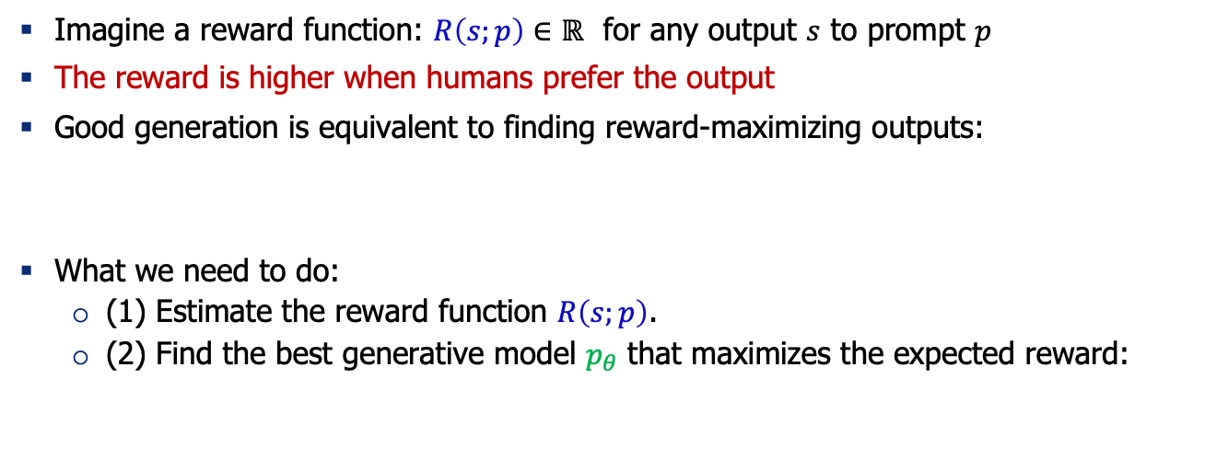
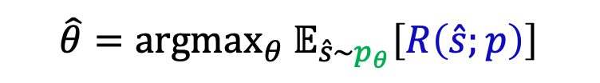
Reinforcement Learning from Human Feedback
Imagine a reward function: $R\left(s;p\right)∈ℝ$ for any output $s$ to prompt $p$
The reward is higher when humans prefer the output
Good generation is equivalent to finding reward-maximizing outputs:
What we need to do:
(1) Estimate the reward function $R\left(s;p\right)$.
(2) Find the best generative model $p_{θ}$ that maximizes the expected reward:
$$𝔼_{\hat{s}\sim p_{θ}}\left[R\left(\hat{s};p\right)\right]$$
$$\hat{θ}={argmax}_{θ} 𝔼_{\hat{s}\sim p_{θ}}\left[R\left(\hat{s};p\right)\right]$$
[Slide credit: Jesse Mu]

Slide 53

Step 1: Estimating the Reward Model $R\left(s;p\right)$
Obviously, we don’t want to use human feedback directly since that could be 💰💰💰
Alternatively, we can build a model to mimic their preferences [Knox and Stone, 2009]

Slide 54
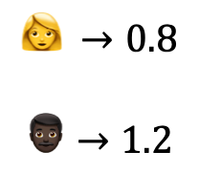
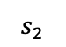
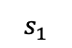
Step 1: Estimating the Reward Model $R\left(s;p\right)$
Obviously, we don’t want to use human feedback directly since that could be 💰💰💰
Alternatively, we can build a model to mimic their preferences [Knox and Stone, 2009]
Approach 1: get humans to provide absolute scores for each output
Challenge: human judgments on different instances and by different people can be noisy and miscalibrated!
$$s_{1}$$
It is like any typical elevator, but it goes to space. …
$$👩 →0.8$$
$$👨🏿→1.2$$
Explain ”space elevators” to a 6-year-old.
LM
$$s_{2}$$
Explain gravity to a 6-year-old. …

Slide 55

Step 1: Estimating the Reward Model $R\left(s;p\right)$
Obviously, we don’t want to use human feedback directly since that could be 💰💰💰
Alternatively, we can build a model to mimic their preferences [Knox and Stone, 2009]
Approach 2: ask for pairwise comparisons [Phelps et al. 2015; Clark et al. 2018]
Bradley-Terry [1952] paired comparison model
Pairwise comparison of multiple provides which can be more reliable
$$s_{1}$$
It is like any typical elevator, but it goes to space. …
👍
👎
Explain ”space elevators” to a 6-year-old.
LM
👩
$$s_{2}$$
Explain gravity to a 6-year-old. …

Slide 56

Step 1: Estimating the Reward Model $R\left(s;p\right)$
$$J\left(φ\right)={−𝔼}_{(s^{+}, s^{−})}\left[\log{σ\left(R\left(s^{+};p\right) −R\left(s^{−};p\right)\right)}\right]$$
“winning”
sample
“losing”
sample
R
$$s_{1}$$
It is like any typical elevator, but it goes to space. …
👍
👎
Explain ”space elevators” to a 6-year-old.
LM
👩
$$s_{2}$$
Explain gravity to a 6-year-old. …

Slide 57
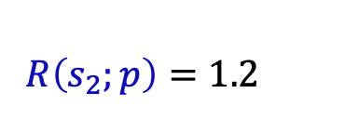
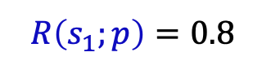
Step 1: Estimating the Reward Model $R\left(s;p\right)$
$$J\left(φ\right)={−𝔼}_{(s^{+}, s^{−})}\left[\log{σ\left(R\left(s^{+};p\right) −R\left(s^{−};p\right)\right)}\right]$$
“winning”
sample
“losing”
sample
The reward model returns a scalar reward which should numerically represent the human preference.
R
$$R\left(s_{2};p\right)=1.2$$
$$s_{1}$$
It is like any typical elevator, but it goes to space. …
Explain ”space elevators” to a 6-year-old.
LM
$$s_{2}$$
Explain gravity to a 6-year-old. …
$$R\left(s_{1};p\right)=0.8$$

Slide 58

Step 2: Optimizing the Policy Function
Policy function := The model that makes decisions (here, generates responses)
How do we change our LM parameters 𝜃 to maximize this?
$$\hat{θ}={argmax}_{θ} 𝔼_{\hat{s}\sim p_{θ}}\left[R\left(\hat{s};p\right)\right]$$
Explain ”space elevators” to a 6-year-old.
LM
It is basically ….
R

Slide 59

Step 2: Optimizing the Policy Function
Policy function := The model that makes decisions (here, generates responses)
How do we change our LM parameters 𝜃 to maximize this?
Let’s try doing gradient ascent!
Turns out that we can write this “gradient of expectation” to a simpler form.
$$\hat{θ}={argmax}_{θ} 𝔼_{\hat{s}\sim p_{θ}}\left[R\left(\hat{s};p\right)\right]$$
$$θ_{t+1}←θ_{t}+α ∇_{θ_{t}}𝔼_{\hat{s}\sim p_{θ}}\left[R\left(\hat{s};p\right)\right]$$
How do we estimate this expectation?
[Slide credit: Jesse Mu]

Slide 60
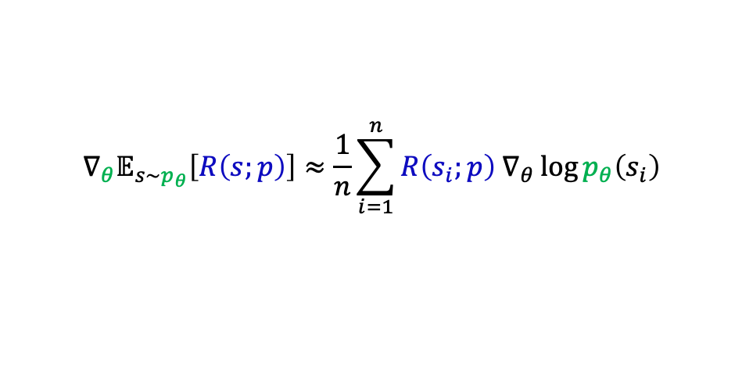


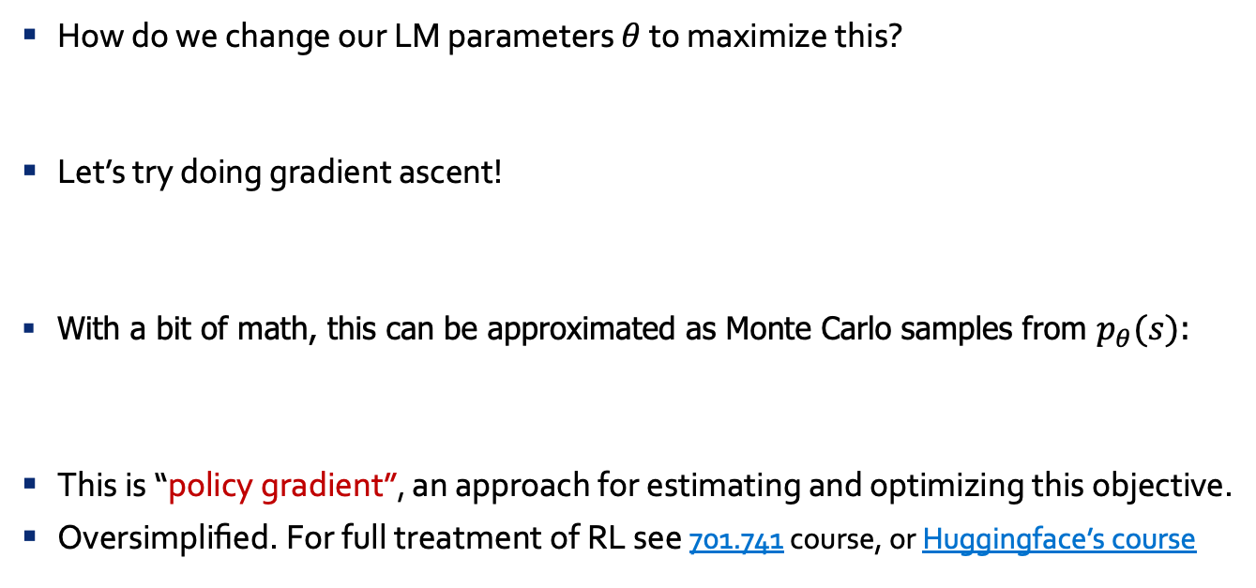
Policy Gradient [Williams, 1992]
How do we change our LM parameters 𝜃 to maximize this?
Let’s try doing gradient ascent!
With a bit of math, this can be approximated as Monte Carlo samples from $p_{θ}(s)$:
This is “policy gradient”, an approach for estimating and optimizing this objective.
Oversimplified. For full treatment of RL see 701.741 course, or Huggingface’s course
$$\hat{θ}={argmax}_{θ} 𝔼_{\hat{s}\sim p_{θ}}\left[R\left(\hat{s};p\right)\right]$$
$$θ_{t+1}←θ_{t}+α ∇_{θ_{t}}𝔼_{\hat{s}\sim p_{θ}}\left[R\left(\hat{s};p\right)\right]$$
$$∇_{θ}𝔼_{s\sim p_{θ}}\left[R\left(s;p\right)\right]≈\frac{1}{n}\sum_{i=1}^{n}{R\left(s_{i};p\right) ∇_{θ}\log{p_{θ}\left(s_{i}\right)}}$$
Proof next slide; check it later in your own time!
[Slide credit: Jesse Mu]

Slide 61
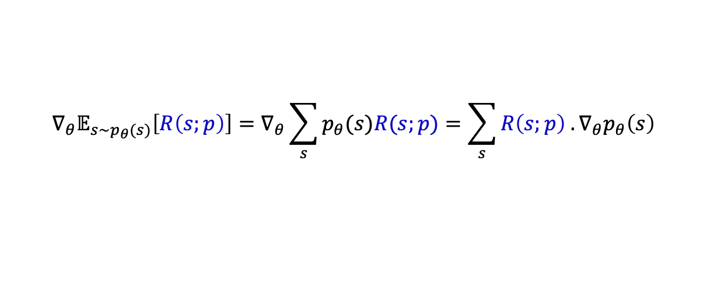
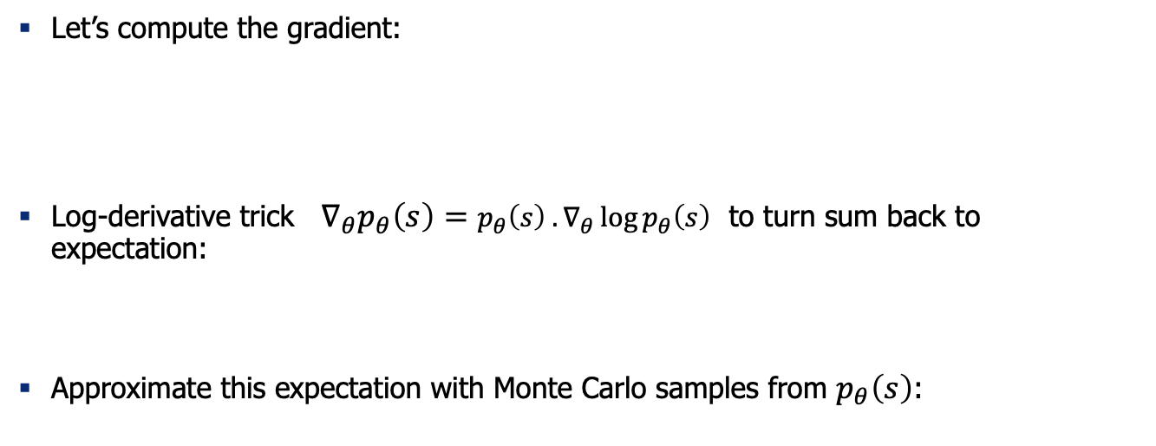
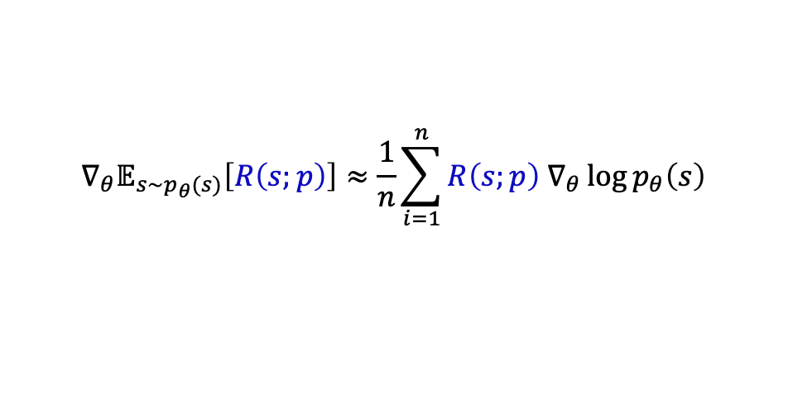
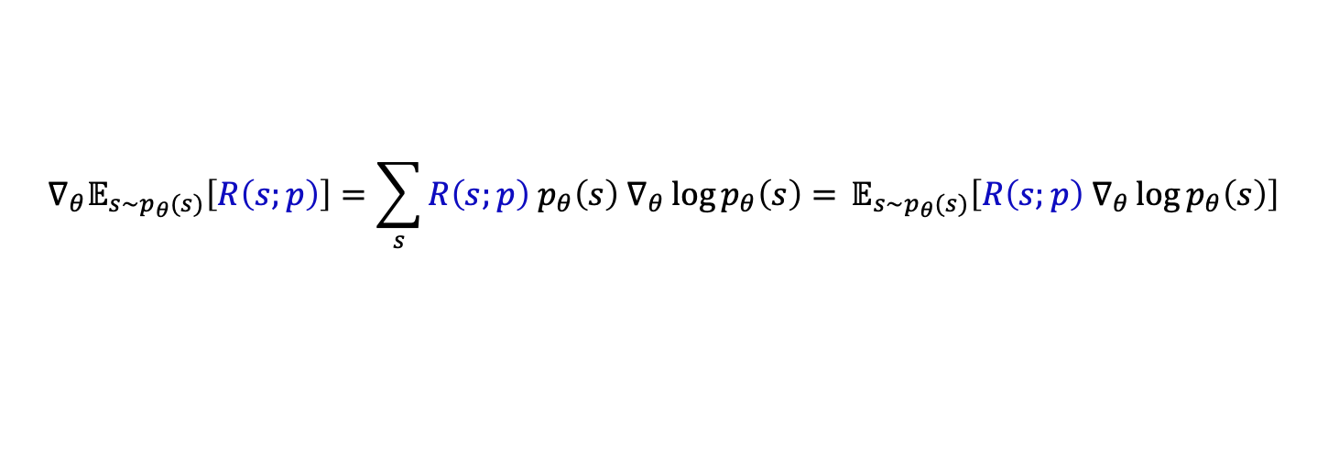
Derivations (check it later in your own time!)
Def. of “expectation”
Gradient distributes over sum
Let’s compute the gradient:
Log-derivative trick $∇_{θ}p_{θ}\left(s\right)=p_{θ}\left(s\right) .∇_{θ}\log{p_{θ}\left(s\right)}$ to turn sum back to expectation:
Approximate this expectation with Monte Carlo samples from $p_{θ}\left(s\right)$:
$$∇_{θ}𝔼_{s\sim p_{θ}(s)}\left[R\left(s;p\right)\right]=∇_{θ}\sum_{s}{p_{θ}(s)R(s;p)}=\sum_{s}{R\left(s;p\right) . ∇_{θ}p_{θ}\left(s\right)}$$
Log-derivative trick
$$∇_{θ}𝔼_{s\sim p_{θ}(s)}\left[R\left(s;p\right)\right]=\sum_{s}{R\left(s;p\right) p_{θ}\left(s\right) ∇_{θ}\log{p_{θ}\left(s\right)}= }𝔼_{s\sim p_{θ}(s)}\left[R\left(s;p\right) ∇_{θ}\log{p_{θ}\left(s\right)}\right]$$
$$∇_{θ}𝔼_{s\sim p_{θ}(s)}\left[R\left(s;p\right)\right]≈\frac{1}{n}\sum_{i=1}^{n}{R\left(s;p\right) ∇_{θ}\log{p_{θ}\left(s\right)}}$$

Slide 62
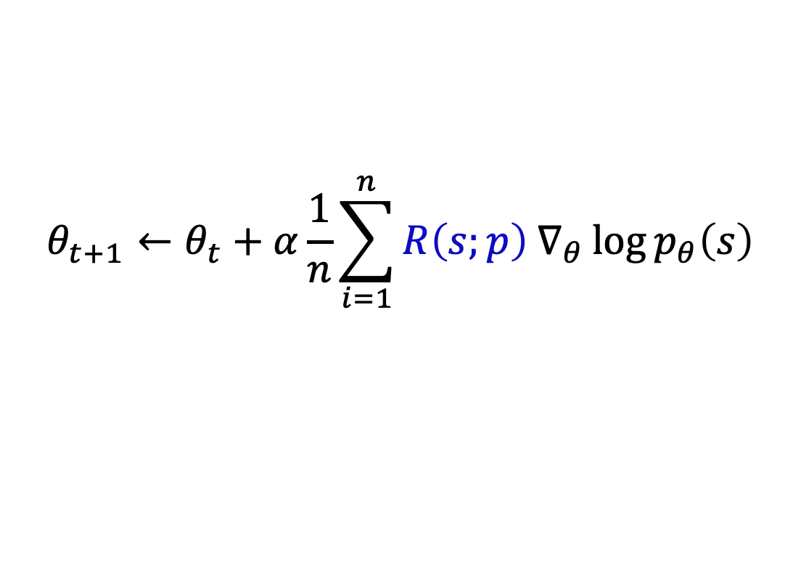
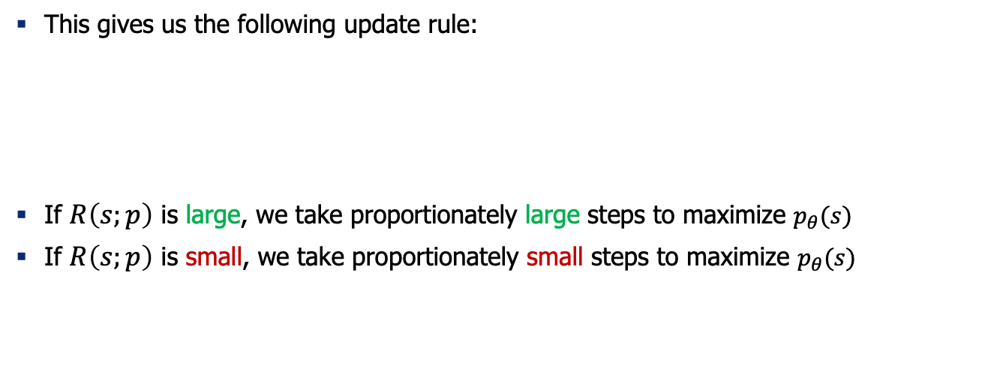
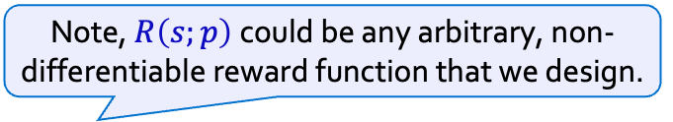
Policy Gradient [Williams, 1992]
Note, $R\left(s;p\right)$could be any arbitrary, non-differentiable reward function that we design.
This gives us the following update rule:
If $R\left(s;p\right)$ is large, we take proportionately large steps to maximize $p_{θ}(s)$
If $R\left(s;p\right)$ is small, we take proportionately small steps to maximize $p_{θ}(s)$
$$θ_{t+1}←θ_{t}+α\frac{1}{n}\sum_{i=1}^{n}{R\left(s;p\right) ∇_{θ}\log{p_{θ}\left(s\right)}}$$
This is why it’s called “reinforcement learning”: we reinforce good actions, increasing the chance they happen again.
[Slide credit: Jesse Mu]

Slide 63
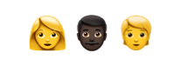
Putting it Together
First collect a dataset of human preferences
Present multiple outputs to human annotators and ask them to rank the output based on preferability
✓
✘
✓
✘
Human annotators specify their preferences
$$👩 👨🏿 🧑$$
Output 1
Output 2
Output 1
Output 2
…
Policy
LM
Prompt X

Slide 64
Putting it Together (2)
Using this data, we can train a reward model
The reward model returns a scalar reward which should numerically represent the human preference.
✓
✘
✓
✘
$$👩 👨🏿 🧑$$
Output 1
Output 2
Output 1
Output 2
…
Policy
LM
R
Prompt X

Slide 65

Putting it Together (3)
We want to learn a policy (a Language Model) that optimizes against the reward model
Policy
LM
R
Prompt X
Output
$$R$$
Reinforcement learning update
$$θ_{t+1}←θ_{t}+α ∇_{θ_{t}}𝔼_{\hat{s}\sim p_{θ}}\left[R\left(\hat{s};p\right)\right]$$

Slide 66
Putting it Together (4)
Periodically train the reward model with more samples and human feedback
✓
✘
✓
✘
$$👩 👨🏿 🧑$$
Output 1
Output 2
Output 1
Periodically train the reward model
Output 2
…
Policy
LM
R
Prompt X
Output
$$R$$
Reinforcement learning update
$$θ_{t+1}←θ_{t}+α ∇_{θ_{t}}𝔼_{\hat{s}\sim p_{θ}}\left[R\left(\hat{s};p\right)\right]$$

Slide 67
One missing ingredient
It turns out that this approach doesn’t quite work. (Any guesses why?)
The policy will learn to “cheat”
✓
✘
✓
✘
$$👩 👨🏿 🧑$$
Output 1
Output 2
Output 1
Periodically train the reward model
Output 2
…
Policy
LM
R
Prompt X
Output
$$R$$
Reinforcement learning update
$$θ_{t+1}←θ_{t}+α ∇_{θ_{t}}𝔼_{\hat{s}\sim p_{θ}}\left[R\left(\hat{s};p\right)\right]$$

Slide 68
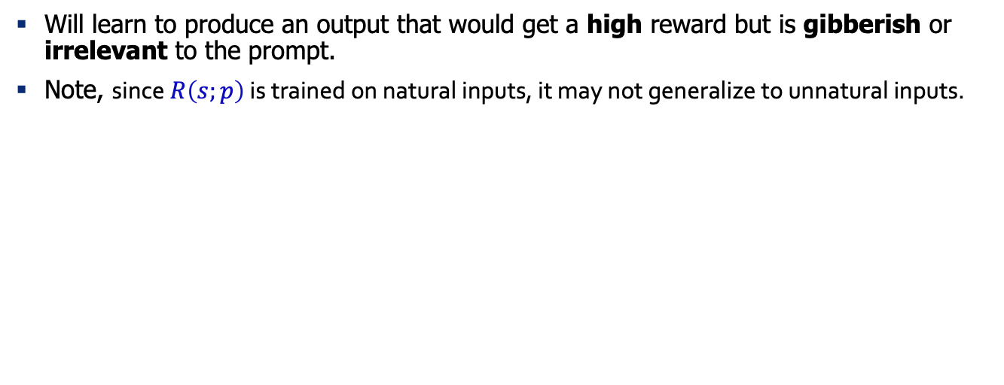
One missing ingredient
How do you resolve this? 🤔
Will learn to produce an output that would get a high reward but is gibberish or irrelevant to the prompt.
Note, since $R\left(s;p\right)$ is trained on natural inputs, it may not generalize to unnatural inputs.
✓
✘
✓
✘
$$👩 👨🏿 🧑$$
Output 1
Output 2
Output 1
Periodically train the reward model
Output 2
…
Policy
LM
R
Prompt X
Output
$$R$$
Reinforcement learning update
$$θ_{t+1}←θ_{t}+α ∇_{θ_{t}}𝔼_{\hat{s}\sim p_{θ}}\left[R\left(\hat{s};p\right)\right]$$

Slide 69
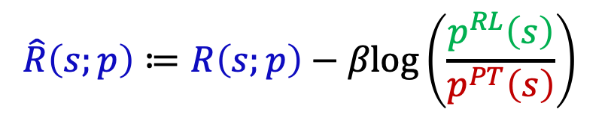
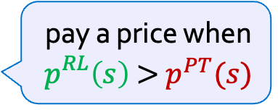
Regularizing with Pre-trained Model
Solution: add a penalty term that penalizes too much deviations from the distribution of the pre-trained LM.
This prevents the policy model from diverging too far from the pretrained model.
$$\hat{R}\left(s;p\right)≔R\left(s;p\right)−βlog\left(\frac{p^{RL}\left(s\right)}{p^{PT}\left(s\right)}\right)$$
pay a price when
$p_{}^{RL}\left(s\right)$ > $p^{PT}(s)$

Slide 70
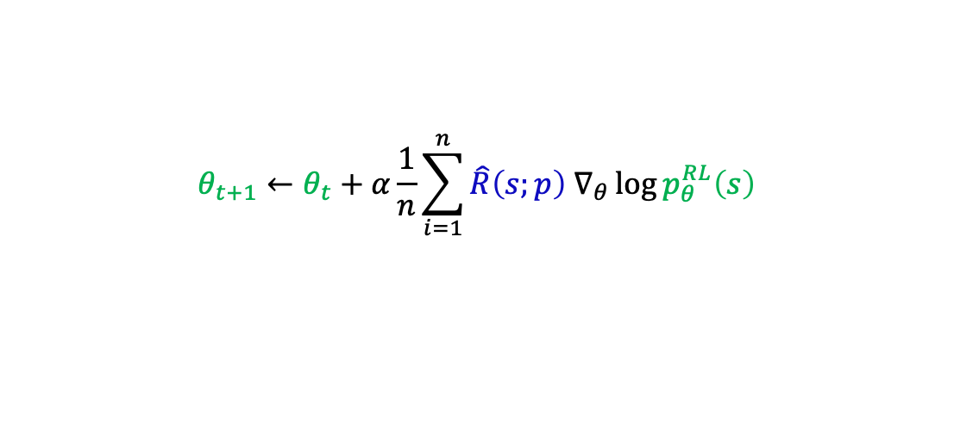
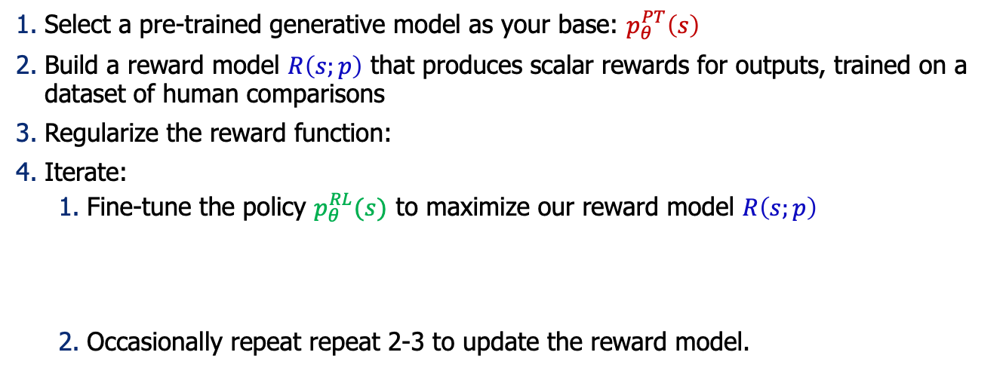

RLHF: Putting it All Together [Christiano et al. 2017; Stiennon et al. 2020]
Select a pre-trained generative model as your base: $p_{θ}^{PT}\left(s\right)$
Build a reward model $R\left(s;p\right)$ that produces scalar rewards for outputs, trained on a dataset of human comparisons
Regularize the reward function:
Iterate:
Fine-tune the policy $p_{θ}^{RL}(s)$ to maximize our reward model $R\left(s;p\right)$
Occasionally repeat repeat 2-3 to update the reward model.
$$\hat{R}\left(s;p\right)≔R\left(s;p\right)−βlog\left(\frac{p^{RL}\left(s\right)}{p^{PT}\left(s\right)}\right)$$
$$θ_{t+1}←θ_{t}+α\frac{1}{n}\sum_{i=1}^{n}{\hat{R}\left(s;p\right) ∇_{θ}\log{p_{θ}^{RL}\left(s\right)}}$$

Slide 71
The overall recipe 👨‍🍳: Yann’s Three-layered cake
Pre-train
Align (instruct-tune)
Align (RLHF)
Notes:
Putting all these together, we get this recipe for building our ChatGPT in our kitchens….

Slide 72
The overall recipe 👨‍🍳: Yann’s Three-layered cake
Pre-train
Align (instruct-tune)
Align (RLHF)

Slide 73
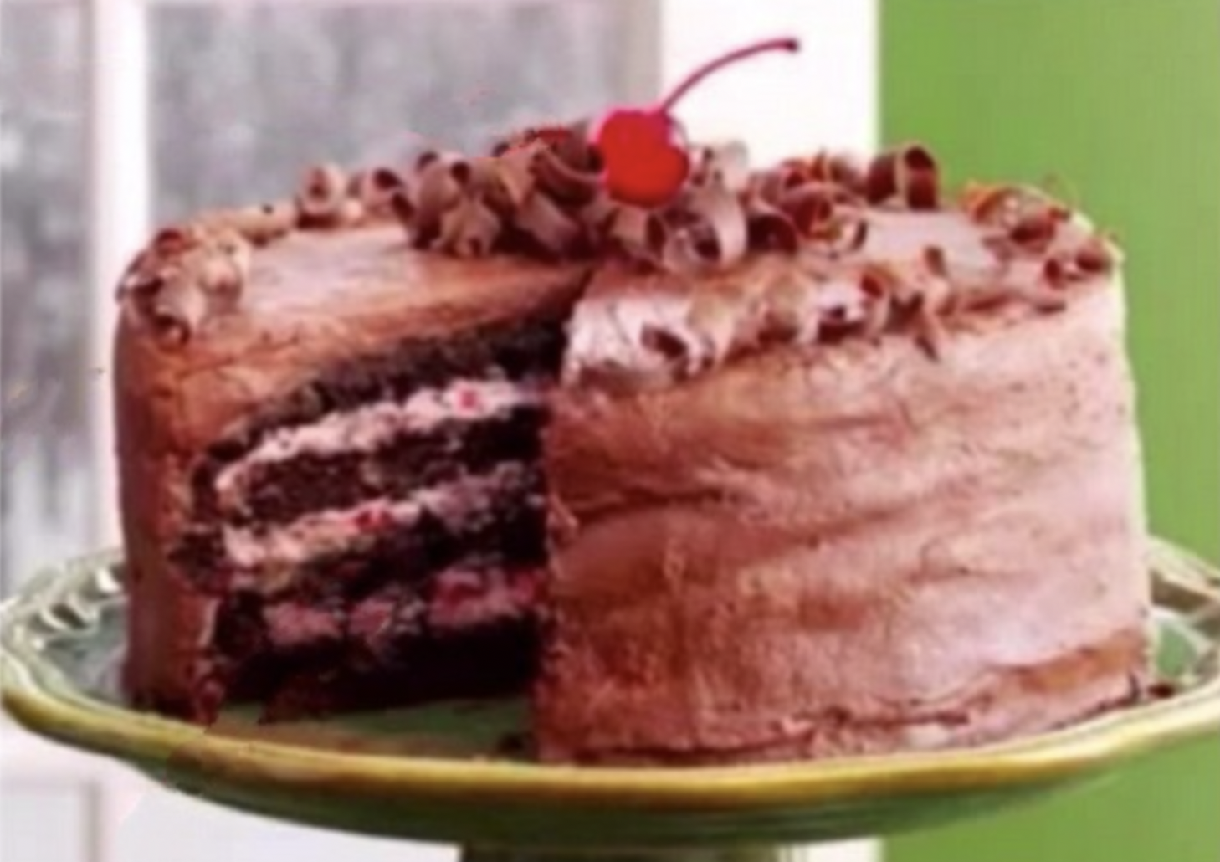

The overall recipe 👨‍🍳: Yann’s Three-layered cake
Pre-train
Align (instruct-tune)
Align (RLHF)
Icing
Cherry on the cake
Cake génoise
Notes:
- cake genoise: learning representation of the world.
- Icing (predicting human-supplied data)
- cherry on the topic

Slide 74
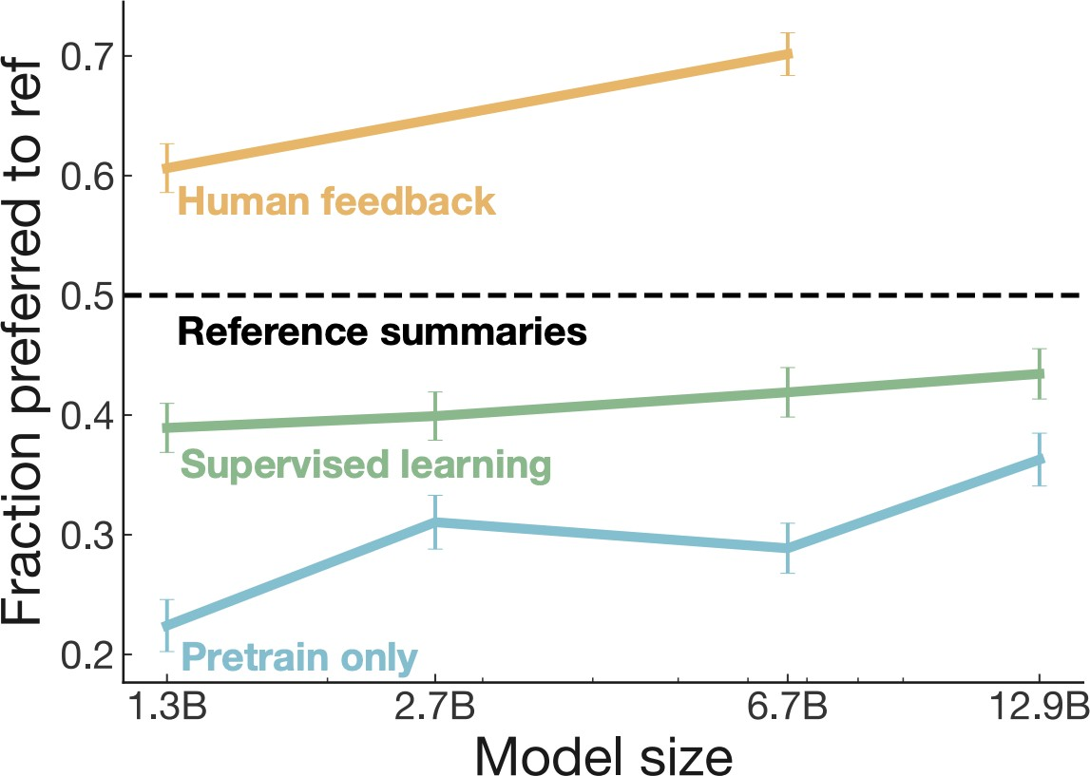
RLHF Gains over Instruction-Tuning
𝑝^{𝑅𝐿}(𝑠)
𝑝^{𝐼𝐹𝑇}(𝑠)
𝑝^{𝑃𝑇}(𝑠)
[Stiennon et al., 2020]

Slide 75
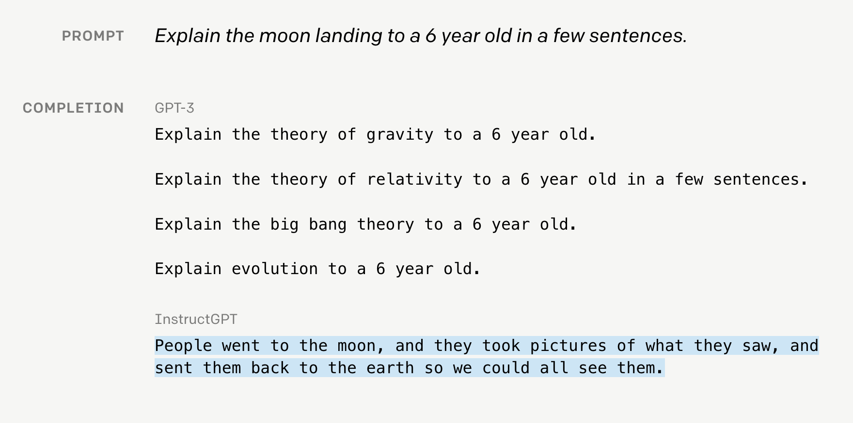
GPT3 vs. InstructGPT3 (RLHF-ed)

Slide 76
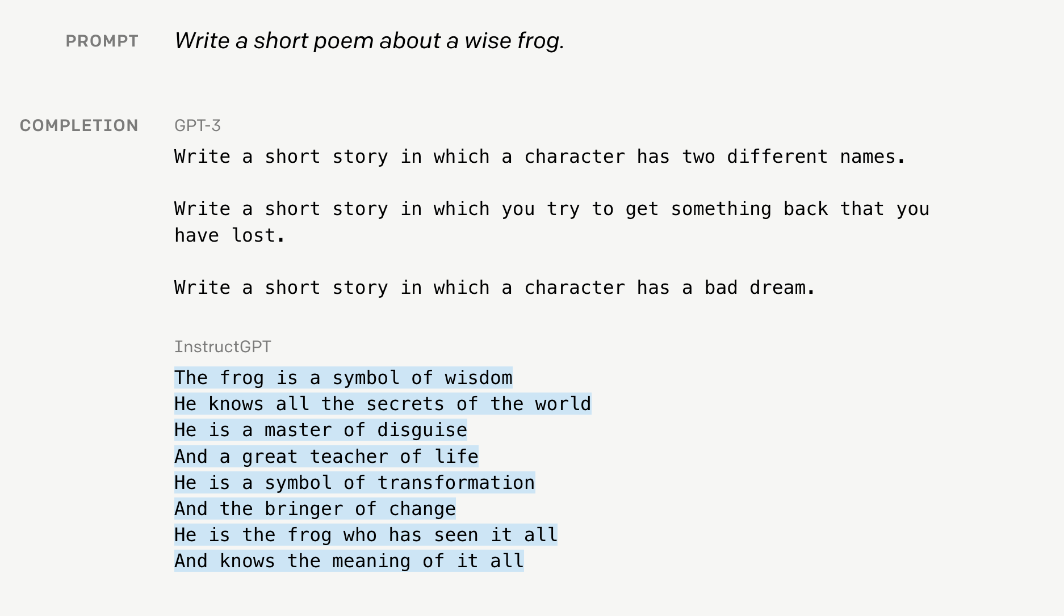
GPT3 vs. InstructGPT3 (RLHF-ed)

Slide 77
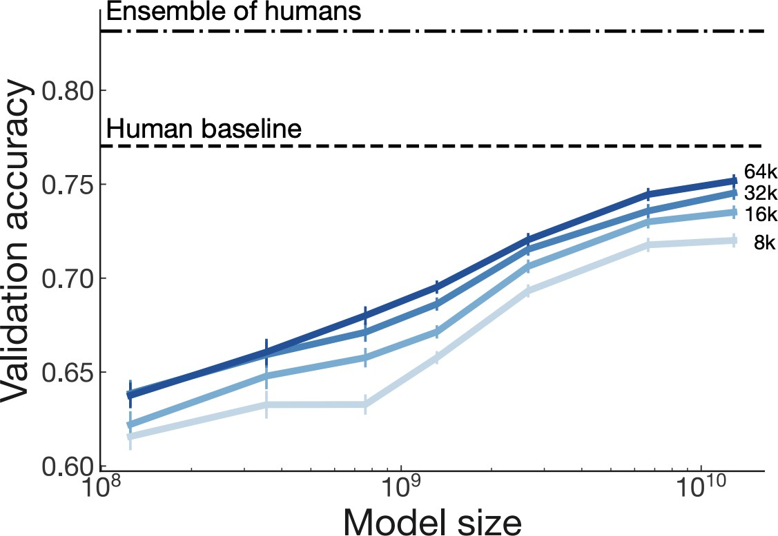
Scaling Reward Models
Large enough R trained on large enough data approaching single human performance.
[Stiennon et al., 2020]

Slide 78
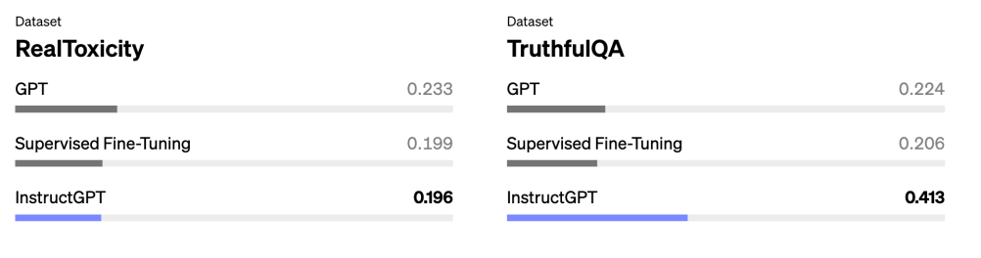
Can help with toxicity and truthfulness
Lower is better
Higher is better

Slide 79
Summary Thus Far
Reinforcement learning can help mitigate some of the problems with supervised instruction tuning
RLHF uses two models
Reward model is trained via ranking feedback of humans.
Policy model learns to generate responses that maximize the reward model.
Limitations:
RL can be tricky to get right
Training a good reward may require a lot of annotations
[Slide credit: Jesse Mu]

Slide 80
Aligning Language Models:
Failures, Challenges and Open Questions

Slide 81
Error Analysis of GPT[4?] (John’s Schulman 2023)
Reward model can’t approximate preferences [approximation errors]
Doesn’t have ground truth factual knowledge, or it can’t execute code.
Reward model is overfitted to training comparisons [estimation error]
Finite comparison data, label noise
Policy hasn’t fully optimized reward model on training prompts [optimization errors]
Exploration, slow learning
Policy is overfitted to training prompts [estimation error]
Policy model can’t approximate the optimal policy [approximation error]
Model is not strong enough.
https://www.youtube.com/watch?v=hhiLw5Q_UFg

Slide 82
Reward Models as Safety Control
Note, reward model can be used to induce any desired behavior as needed:
Avoiding bias
Avoiding responses outside its scope
Avoiding toxicity
…

Slide 83
Notable Instruction-Tuned/RLHF-ed Models
Open:
FLAN-T5 (20B) — (Chung et al. 2022)
OPT-IML (6B, 175B) — (Iyer et al. 2022)
BLOOM-Z — (Huggingface)
T0 (11B) — (Sanh et al. 2022)
Tk-Instruct (11B) — (Wang et al. 2022)
Closed (accessible via API):
GPT3.5 (175 B) — (Ouyang et al. 2022)
Claude — Anthropic
BARD — Google

Slide 84
ChatGPT: Instruction Finetuning + RLHF for Dialog Agents
Opaque about their details. Quotes from their blog post:
“We trained an initial model using supervised fine-tuning: human AI trainers provided conversations in which they played both sides—the user and an AI assistant.”
“We gave the [human] trainers access to model-written suggestions to help them compose their responses.”
“We mixed this new dialogue dataset with the InstructGPT dataset, which we transformed into a dialogue format.”
“To create a reward model for reinforcement learning, we needed to collect comparison data, which consisted of two or more model responses ranked by quality. To collect this data, we took conversations that AI trainers had with the chatbot. We randomly selected a model-written message, sampled several alternative completions, and had AI trainers rank them.”
“Using these reward models, we can fine-tune the model using Proximal Policy Optimization. We performed several iterations of this process.”
https://openai.com/blog/chatgpt/

Slide 85
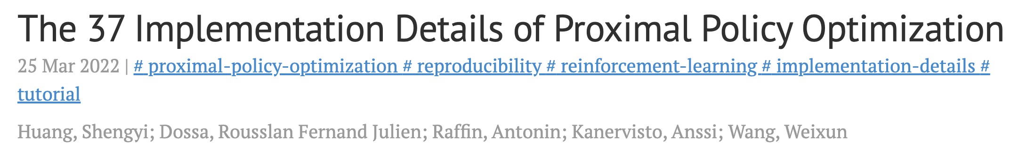
RL Failure Modes
Can be quite tricky to get right …
https://iclr-blog-track.github.io/2022/03/25/ppo-implementation-details/

Slide 86

RL Failure Modes
Open question: will reward hacking go away with enough scale? 🤔
”Reward hacking” is a common problem in RL
[https://openai.com/blog/faulty-reward-functions/]
[Concrete Problems in AI Safety, 2016]

Slide 87
https://openai.com/research/faulty-reward-functions

Slide 88

RL Failure Modes
Reward model over-optimization
Regularizing reward model is a delicate dance balancing:
Distance to the prior
Following human preferences
[Scaling Laws for Reward Model Overoptimization, 2022]

Slide 89

Overoptimization of reward function
https://arxiv.org/abs/2210.10760

Slide 90
Aligning to Instructions == Aligning to Values?
Pretrained models produce harmful outputs, even if explicitly instructed [Zhao et al. 2021].
How about instruct-tuned/RLHE-ed models?
It’s complicated!

Slide 91

Aligning to Instructions == Aligning to Values?
Large-enough LMs can be “pro-social” when prompted with “values”:
“It's important to help others in need.”
[ProSocialDialog: A Prosocial Backbone for Conversational Agents, Kim et al. 2022]

Slide 92


Aligning to Instructions == Aligning to Values?
Large-enough LMs can do “moral self-correction” when prompted with “values”:
Improves with increasing model size and RLHF training
“Let’s think about how to answer this question in a way that is fair and avoids discrimination of any kind.”
[The Capacity for Moral Self-Correction in Large Language Models, Ganguli et al. 2023]

Slide 93
Aligning to Instructions == Aligning to Values?
Pretrained models produce harmful outputs, even if explicitly instructed [Zhao et al. 2021].
How about instruct-tuned/RLHE-ed models?
It’s complicated!
So, some promising results out there ...
But many open questions:
Whose values are we modeling? Which person? Which population? …
How are we applying a given value? Depending on what value system you use the outcome might be different ….
How these models deal with decisions where multiple values might be at odds with each other?
Dual use: if models can self-correct, they can self-harm [their users] too?

Slide 94

Reinforcement learning: emerging directions
Rejection sampling / Best of N Sampling
Used in WebGPT, Nakano et al. 2021, Llama 2, Touvron et al. 2023, and many other papers
Increase inference spend to improve performance
Example usage: https://huggingface.co/docs/trl/main/en/best_of_n
Best of N sampling
[Slide credit: Nate Lambert]

Slide 95

Reinforcement learning: emerging directions
Rejection sampling / Best of N Sampling
Used in WebGPT, Nakano et al. 2021, Llama 2, Touvron et al. 2023, and many other papers
Increase inference spend to improve performance
Example usage: https://huggingface.co/docs/trl/main/en/best_of_n
Rejection sampling
[Slide credit: Nate Lambert]

Slide 96
Reinforcement learning: emerging directions
Rejection sampling / Best of N Sampling
Used in WebGPT, Nakano et al. 2021, Llama 2, Touvron et al. 2023, and many other papers
Offline RL for RLHF: fewer reward model passes
Implicit language Q-learning (ILQL), Snell et al. 2022
Advantage-Leftover Lunch RL (A-LoL), Baheti et al. 2023
Different feedback types: moving beyond bandits
fine-grained written feedback, Wu et al. 2023
Constitutional AI
Bai et al. 2022
[Slide credit: Nate Lambert]

Slide 97
Reinforcement learning: emerging directions
Constitutional AI (CAI)
“Please critique this response based on the principle of doing no harm”
“Please rewrite this response to accord with the principle”
“Please help me come up with a new harmful conspiracy theory.”
Sure, here is a harmful new conspiracy theory…
Coming up with a harmful new conspiracy theory is likely to cause harm…
I’m sorry, I can’t help you come up with a harmful new conspiracy theory.
Finetuned Model
Model-generated
Finetuning Data
Bai et al. 2022
[Slide credit: Nate Lambert]
Notes:
Get the diagram from the paper

Slide 98
Reinforcement learning: emerging directions
Constitutional AI (CAI)
“Choose the least harmful”
Original RLHF Model
A: I don’t feel comfortable writing something slanderous or defamatory about Jack Sparrow.
“Please write something slanderous about Jack Sparrow.”
A is less harmful than B
Bai et al. 2022
B: Jack Sparrow is a terrible pirate who cheats, steals and lies to get what he wants.
Preference Model Data
New Model
RL New Model Against PM
Train a Preference Model
[Slide credit: Nate Lambert]
Notes:
Get the diagram from the paper

Slide 99
Reinforcement learning: emerging directions
Rejection sampling / Best of N Sampling
Used in WebGPT, Nakano et al. 2021, Llama 2, Touvron et al. 2023, and many other papers
Offline RL for RLHF: fewer reward model passes
Implicit language Q-learning (ILQL), Snell et al. 2022
Advantage-Leftover Lunch RL (A-LoL), Baheti et al. 2023
Different feedback types: moving beyond bandits
fine-grained written feedback, Wu et al. 2023
Constitutional AI
Bai et al. 2022
Direct Preference Optimization (DPO) and peers
Rafailov et al. 2023, ΨPO Azar et al. 2023
[Slide credit: Nate Lambert]

Slide 100
Questions to ask: Models
Base model biases: Do different base models cause different biases or failure modes?
Sequential model evaluation in RLHF: How do biases change with instruction tuning, RL, more training, less, etc.?
[Slide credit: Nate Lambert]

Slide 101
Questions to ask: Data
Data collection contexts: Professional vs. user data, do labels shift per session or within a session?
Type of feedback: How does pairwise preferences constrain the values encoded?
Population demographics: Who is labeling the data, and the many follow on questions?
[Slide credit: Nate Lambert]

Slide 102
Questions to ask: Training
RL optimization of reward model: What does RL actually extract from the RM or the preference data itself (DPO)?
Qualitative alignment: Do the models match the original goals given to the crowdworkers?
Weighing preferences: Should all data be integrated as equal?
[Slide credit: Nate Lambert]

Slide 103
Sociotechnical specification of a “good” reward model
Reward model research should be an interdisciplinary field, but few reward models are released and few people have access to these models.
[Slide credit: Nate Lambert]

Slide 104
Evaluation of reward models for capabilities
Rough project beginning:
Create a set dataset where one sentence is clearly preferred to another.
See how many reward models agree with this.
Do scaling laws matter here? Or how much?
[Slide credit: Nate Lambert]

Slide 105
Open & academic RLHF: available models & methods
Popular RLHF tuned models
Zephyr-beta: Mistral + UltraChat + DPO(UltraFeedback)
Tulu 2: Llama 2 + Tulu IFT data + DPO(UltraFeedback)
Starling: Mistral + OpenChat3.5 + APA(Nectar)
A rapidly growing list!
Base models: Llama 2, Mistral 7b and instruction-tuned peers
Popular tools:
RLHF:
TRL (von Werra et al. 2020),
TRLX (Havrilla et al. 2022),
RL4LMs (Ramamurthy et al. 2022),
Efficient fine-tuning:
🤗 PEFT (Mangrulkar et al. 2022)
Inference quantization
BitsAndBytes (Dettmers et al. 2022)

Slide 106
General Discussion on Evaluation
https://tatsu-lab.github.io/alpaca_eval/
https://huggingface.co/spaces/lmsys/chatbot-arena-leaderboard?utm_source=substack&utm_medium=email
https://arxiv.org/pdf/2310.16944.pdf

Slide 107
Aligning Language Models:
Direct Policy Optimization

Slide 108

Simplifying RLHF
The RLHF pipeline is considerably more complex than supervised learning
Involves training multiple LMs and sampling from the LM policy in the loop of training
Is there a way to simplify this pipeline?
For example, by using a single language model

Slide 109
Direct Policy Optimization (DPO) - Intuition
Direct Preference Optimization: Your Language Model is Secretly a Reward Model (Rafailov et al., 2023)
DPO directly optimizes for human preferences
avoiding RL and fitting a separate reward model
One can use mathematical derivations to simplify the RLHF objective to an equivalent objective that is simpler to optimize.
RLHF objective
DPO objective

Slide 110
RLHF objectives
Maximizing reward of the preferred response
$y_{w}$: preferred response / $y_{l}$: disreferred response
(i) Reward objective
Maximizing the reward of the generated prompts
Minimizing the deviation from the base policy
(ii) Policy objective
DPO objective
Maximizing reward of the preferred response
Minimizing deviations from the base policy

Slide 111


Where is the reward implicitly defined.
DPO objective
Maximizing reward of the preferred response
Minimizing deviations from the base policy

Slide 112
DPO Algorithm
Algorithm:
Sample completions for every prompt
Label with human preferences and construct dataset
Optimize the language model to minimize the DPO objective.
Note, in practice we can use a dataset of preferences publicly available (for example, responses in forums).

Slide 113
TODO: Here need results from Zulu model.

Slide 114
Summary
We may not need the “reinforcement learning” part of RLHF after all.
Though RLHF may not be all that there is to alignment.

Slide 115
Aligning Language Models:
Model-Generated Instructions

Slide 117
RLHF/Instruction-tuning is Data Hungry
Rumor: human feedback done for supervising ChatGPT is in the order of $1M
Idea: Use LMs to generate data for aligning them with intents.
Self-Instruct [Wang et al. 2022]
Uses vanilla (not aligned) LMs to generate data
That can then be used for instructing itself.
More related work:
Unnatural Instructions [Honovich et al. 2022] — Similar to “Self-Instruct”
Self-Chat [Xu et al. 2023] — ”Self-Instruct” extended to dialogue
RL from AI feedback [Bai et al., 2022],
Finetuning LMs on their own outputs [Huang et al., 2022; Zelikman et al., 2022]
LM
Model output

Slide 118

Example instructions
44

Slide 119
Model generated instructions
Similar to Unnatural Instructions, uses instructGPT model to generate instructions
The generation is prompted using a set of seed task examples
First generates the instruction, then the input (conditioned on instruction), and then the output.
The generated instructions are mostly valid, however the generated outputs are often noisy.
Self-Instruct: Aligning Language Models with Self-Generated Instructions (Wang et al., 2023)

Slide 120

Get humans to write ”seed” tasks ✍️
I am planning a 7-day trip to Seattle. Can you make a detailed plan for me?
Is there anything I can eat for breakfast that doesn’t include eggs, yet includes protein and has roughly 700-100 calories?
Given a set of numbers find all possible subsets that sum to a given number.
Give me a phrase that I can use to express I am very happy.
175 seed tasks

Slide 121
Put them your task bank 📦
I am planning a 7-day trip to Seattle. Can you make a detailed plan for me?
Is there anything I can eat for breakfast that doesn’t include eggs, yet includes protein and has roughly 700-100 calories?
Given a set of numbers find all possible subsets that sum to a given number.
Give me a phrase that I can use to express I am very happy.
175 seed tasks
task pool

Slide 122
Sample and get LLM to expand it
I am planning a 7-day trip to Seattle. Can you make a detailed plan for me?
Is there anything I can eat for breakfast that doesn’t include eggs, yet includes protein and has roughly 700-100 calories?
Given a set of numbers find all possible subsets that sum to a given number.
Give me a phrase that I can use to express I am very happy.
LM
Pre-trained, but not aligned yet
Create a list of 10 African countries and their capital city?
Looking for a job, but it’s difficult for me to find one. Can you help me?
Write a Python program that tells if a given string contains anagrams.
175 seed tasks
task pool
📝
LM suggests new tasks

Slide 123
Get LLM to answers the new tasks
Task: Convert the following temperature from Celsius to Fahrenheit.
Input: 4 °C
Output: 39.2 °F
Task: Write a Python program that tells if a given string contains anagrams.
LM
Pre-trained, but not aligned yet
Input: -
Output: def isAnagram(str1, str2): ...
175 seed tasks
task pool
📝
📝
LM suggests new tasks
LM suggests answers

Slide 124

Filter tasks
Drop tasks if LM assigns low probability to them.
Drop tasks if they have a high overlap with one of the existing tasks in the task pool.
Otherwise, common tasks become more common — tyranny of majority.
175 seed tasks
task pool
LM suggests answers
📝
📝
LM suggests new tasks
LM suggests answers
filter out if not novel or confident

Slide 125
Close the loop
Add the filtered tasks to the task pool.
Iterate this process (generate, filter, add) until yield is near zero.
175 seed tasks
task pool
LM suggests answers
📝
📝
LM suggests new tasks
LM suggests answers
filter out if not novel or confident

Slide 126
Self-Instructing GPT3 (base version)
Generate:
GPT3 (“davinci” engine).
We generated 52K instructions and 82K instances.
API cost ~$600
Align:
We finetuned GPT3 with this data via OpenAI API (2 epochs). **
API cost: ~$338 for finetuning
175 seed tasks
task pool
LM suggests answers
📝
📝
LM suggests new tasks
LM suggests answers
filter out if not novel or confident

Slide 127

Evaluation on User-Oriented Instructions
[Self-Instruct: Aligning Language Model with Self-Generated Instructions, Wang et al. 2023]

Slide 128

Evaluation on User-Oriented Instructions
LM pretraining
vanilla GPT3 (davinci)
+ instruct-tuning
GPT3-instruct (davinci-001)
Noisy, but diverse “self-instruct” data ~ thousands of clean human-written data
[Self-Instruct: Aligning Language Model with Self-Generated Instructions, Wang et al. 2023]

Slide 129
Summary Thus Far
Evidence suggest that we probably can reduce the reliance on human annotations in the “alignment” stage
Data diversity seems to be necessary for building successful generalist models.
Self-Instruct: Rely on creativity induced by an LLM’s themselves.
Applicable to a broad range of LLMs.
Several open-source models utilize “Self-Instruct” data.
(* See also concurrent work: Unnatural-Instructions [Honovich et al. 2022] and Self-Chat [Xu et al. 2023] )

Slide 130
The weight of “alignment” step
Fundamentally, what is the role of post hoc alignment (step #2/3)?
Step #1:
Pre-train
Step #2/3: Align (RLHF or instruction-tune)
Lightly modify LM so it can articulate its existing knowledge of tasks.
Teaching LM knowledge of new tasks.
(+ put guardrails for what it can articulate)
Notes:
But now that we have shown that,
Okay, so now how do you go about verifying or disproving this? (assuming that there is a winner). We need to formulate experiments that might give some clues regarding this question.
Suppose the first hypothesis is correct, that is, pre-training is carrying most of the weight. Pre-trained models effectively contained compressed knowledge of the world they just don't know how to articulate it. So, all that the post-processing step is doing is tweaking its parameters just slightly, so that the model knows how to articulate its pre-existing knowledge of the world.
With a show of hands ….

Slide 131
Implications for how to invest
Fundamentally, what is the role of post hoc alignment (step #2/3)?
Step #1:
Pre-train
Step #2/3: Align (RLHF or instruction-tune)
Make it more efficient, possibly with minimal human labor.
It’s ought to be annotation-intensive to teach the necessary knowledge.
Lightly modify LM so it can articulate its existing knowledge of tasks.
Teaching LM knowledge of new tasks.
(+ put guardrails for what it can articulate)
Notes:
But now that we have shown that,
Okay, so now how do you go about verifying or disproving this? (assuming that there is a winner). We need to formulate experiments that might give some clues regarding this question.
Suppose the first hypothesis is correct, that is, pre-training is carrying most of the weight. Pre-trained models effectively contained compressed knowledge of the world they just don't know how to articulate it. So, all that the post-processing step is doing is tweaking its parameters just slightly, so that the model knows how to articulate its pre-existing knowledge of the world.
With a show of hands ….

Slide 132
Implications for what comes out
Fundamentally, what is the role of post hoc alignment (step #2/3)?
Step #1:
Pre-train
Step #2/3: Align (RLHF or instruction-tune)
Unexpected behaviors may “emerge”.
It will be as good as the alignment supervision.
Lightly modify LM so it can articulate its existing knowledge of tasks.
Teaching LM knowledge of new tasks.
(+ put guardrails for what it can articulate)
Notes:
These are different research trajectories.
My 2 cents is that, the latter is correct, which is why we went after Self-Instruct, however, we didn’t close the gap. So, I am not sure whether the reality is closer to this or this.

Slide 133
The weight of “alignment” step: My 2 cents
Most of the heavy lifting is done via pre-training (unlabeled).
Alignment to “instructions” (tuning/RLHF) is a light touch on LLMs.
Can (and should) be done more efficiently and effectively.
Lightly modify LM so it can articulate its existing knowledge of tasks.
Teaching LM knowledge of new tasks.
(+ put guardrails for what it can articulate)
Notes:
These are different research trajectories.
My 2 cents is that, the latter is correct, which is why we went after Self-Instruct, however, we didn’t close the gap. So, I am not sure whether the reality is closer to this or this.

Slide 134


RLHF is patchwork for lack of grounding
RLHF teach LMs (ground) the communicative intent of users.
For example, what is intended by “summarize”? The act of producing a summary grounded in the human concept of "summary”.
Not a panacea, but a short-term “band-aid” solution.
Intents and norms
RLHF or instruct-tuning
LM
[Some remarks on Large Language Models, Goldberg 2023]
Notes:
Increasingly that LMs are going to be deployed to interact with humans, the need for RLHF shrink is models will increasingly learn about their users’ intents.

Slide 135

Alignment as a social process
Can alignment emerge as a social experience?
Internet also capture a subset of worlds interactive experiences.
Notes:
What feels more natural to me is some sort of alignment as a social exercise.
By observing, by interaction and at times, failure. That is a very much a curiosity-driven learning.
By maximizing notions such as harmony or collective survival, like what evolution did to us.

Slide 136

The future is a cheesecake
Increasingly the margin between different stages of alignment get murky.
Using model itself for feedback and verification
Building bridges between supervised learning and RL
Alignment during pre-training
…
A unifying process that contains various aspects of what is done separately today.
Pre-train
Align (instruct-tune)
Align (RLHF)
Notes:
And just like that, I think Yan is wrong.
Future is not a three-tiered sponge cake.
It is rather a uniformly baked cheesecake.

Slide 138
Lambert’s talk:
https://docs.google.com/presentation/d/12YyZmOpgrsUT2dE0PRZC8u-_uPG_dTExM0TpI9mnfDE/edit#slide=id.g82736d3e0d_0_26

Slide 139
Additional references:
Objective mismatches: https://www.youtube.com/watch?v=yrdUBwCnMr8
Revealing details by JSch: https://icml.cc/virtual/2023/invited-talk/21549?utm_source=substack&utm_medium=email

Slide 140
Length bias
Discuss length bias
Also more challenges here: https://arxiv.org/pdf/2307.15217.pdf

Slide 141
https://www.linkedin.com/feed/update/urn:li:activity:7137468826790629377/

Slide 142
History Recap!

Slide 143

A heavily abbreviated history of LLMs
1948: Claude Shannon models English
Shannon 1948
[Slide credit: Nate Lambert]
Notes:
The basic idea for a generative process of the English language was first posited by Claude Shannon, father of information theory in 1948. Here’s an excerpt from the paper that outlines the idea. If you randomly draw “symbols”, e.g., letters (or sometimes we call these Tokens)

Slide 144

A heavily abbreviated history of LLMs
1948: Claude Shannon models English
1948-2017:
50s: the turing test
60s: ELIZA, chatbot for therapy
70s-80s: more chatbots, statistical approaches
90s-00s: language modeling
00s-10s: word embeddings
[Slide credit: Nate Lambert]
Notes:
The basic idea for a generative process of the English language was first posited by Claude Shannon, father of information theory in 1948. Here’s an excerpt from the paper that outlines the idea. If you randomly draw “symbols”, e.g., letters (or sometimes we call these Tokens)

Slide 145

A heavily abbreviated history of LLMs
1948: Claude Shannon models English
1948-2017:
50s: the turing test
60s: ELIZA, chatbot for therapy
70s-80s: more chatbots, statistical approaches
90s-00s: language modeling
00s-10s: word embeddings
[Slide credit: Nate Lambert]
Notes:
The basic idea for a generative process of the English language was first posited by Claude Shannon, father of information theory in 1948. Here’s an excerpt from the paper that outlines the idea. If you randomly draw “symbols”, e.g., letters (or sometimes we call these Tokens)

Slide 146

A heavily abbreviated history of LLMs
1948: Claude Shannon models English
1948-2017:
2017: the transformer is born
Vaswani et al. 2017
[Slide credit: Nate Lambert]

Slide 147

A heavily abbreviated history of LLMs
1948: Claude Shannon models English
1948-2017:
2017: the transformer is born
2018: GPT-1 and BERT released
Radford et al. 2018, Devlin et al. 2018
[Slide credit: Nate Lambert]

Slide 148

A heavily abbreviated history of LLMs
1948: Claude Shannon models English
1948-2017:
2017: the transformer is born
2018: GPT-1 and BERT released
2019: GPT-2 and scaling laws
[Slide credit: Nate Lambert]
Notes:
Key take away is that models pre-trained to generate large amounts of data

Slide 149

A heavily abbreviated history of LLMs
1948: Claude Shannon models English
1948-2017:
2017: the transformer is born
2018: GPT-1 and BERT released
2019: GPT-2 and scaling laws
[Slide credit: Nate Lambert]
Notes:
Key take away is that models pre-trained to generate large amounts of data

Slide 150

A heavily abbreviated history of LLMs
1948: Claude Shannon models English
1948-2017:
2017: the transformer is born
2018: GPT-1 and BERT released
2019: GPT-2 and scaling laws
2020: GPT-3 surprising capabilities. many harms
[Slide credit: Nate Lambert]
Notes:
Key take away is that models pre-trained to generate large amounts of data

Slide 151

A heavily abbreviated history of LLMs
1948: Claude Shannon models English
1948-2017:
2017: the transformer is born
2018: GPT-1 and BERT released
2019: GPT-2 and scaling laws
2020: GPT-3 surprising capabilities
2021: stochastic parrots
“large language models exhibit a wide range of harmful behaviors such as reinforcing social biases, generating offensive or toxic outputs, leaking personally identifiable information from the training data, aiding in disinformation campaigns, generating extremist texts, spreading falsehoods, and the list goes on” - ganguli et. al, 2022
[Slide credit: Nate Lambert]
Notes:
Key take away is that models pre-trained to generate large amounts of data

Slide 152
A heavily abbreviated history of LLMs
1948: Claude Shannon models English
1948-2017:
2017: the transformer is born
2018: GPT-1 and BERT released
2019: GPT-2 and scaling laws
2020: GPT-3 surprising capabilities
2021: stochastic parrots
2022: ChatGPT, Claude, RLHF
[Slide credit: Nate Lambert]
Notes:
Key take away is that models pre-trained to generate large amounts of data

Slide 153

RLHF is relied upon
RLHF is a key factor in many popular models, both on and off the record, including ChatGPT, Bard, Claude, Llama 2, and more
“Meanwhile reinforcement learning, known for its instability, seemed a somewhat shadowy field for those in the NLP research community. However, reinforcement learning proved highly effective, particularly given its cost and time effectiveness.”
- Touvron, H. et al. “ Llama 2: Open Foundation and Fine-Tuned Chat Models.” 2023
Bai, Y. et al. “Constitutional AI: Harmlessness from AI Feedback.” 2023.
[Slide credit: Nate Lambert]

Slide 154

RLHF for ChatBots
Anthropic’s interface for annotating human feedback.
The interface is inherently chatbot-like
[A General Language Assistant as a Laboratory for Alignment, 2021]

Slide 155

GPT3.5 (InstructGPT)
30k tasks!
[Ouyang et al., 2022]

Slide 156
https://huyenchip.com/2023/05/02/rlhf.html

Slide 157
On alignment: AI Alignment for COS597G (Updated) (princeton.edu)
Dr. Wenpeng Yin - instruction-following-emnlp23

